Slide 1
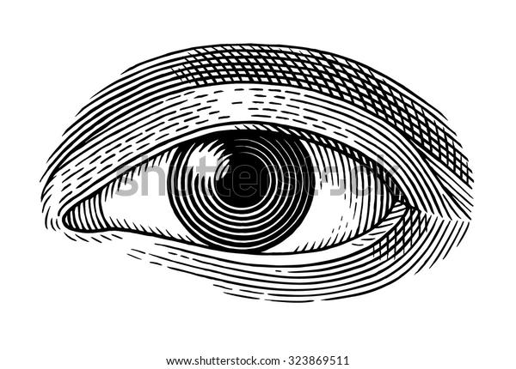
The role of the visual arts in better understanding our world.
By
David Edward Harmon
Applicant

Slide 2
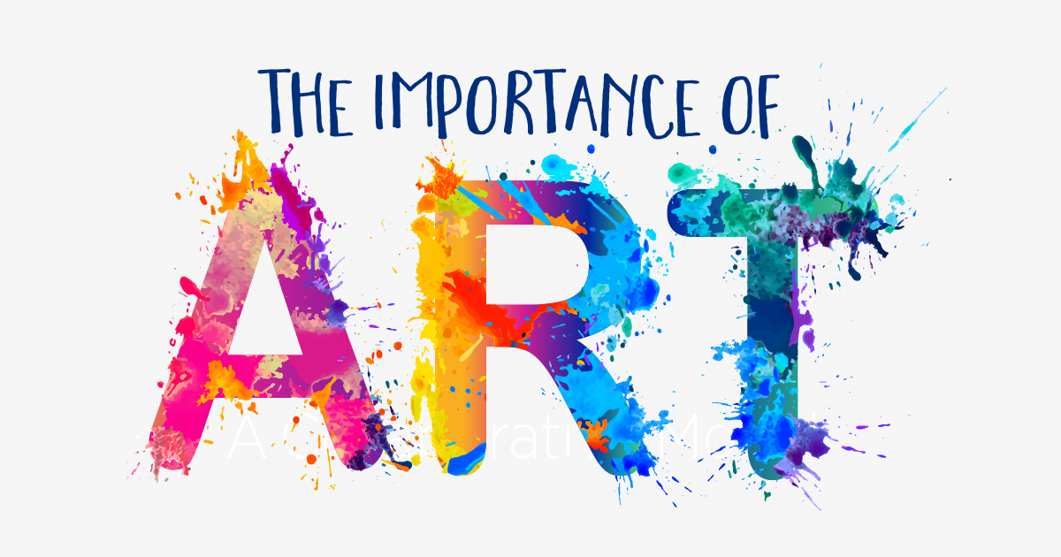
Art is transformative. It advances local and global conversations, highlights new perspectives, and brings forth a vision for the future. It creatively expresses the human experience and propels us forward!

Slide 3
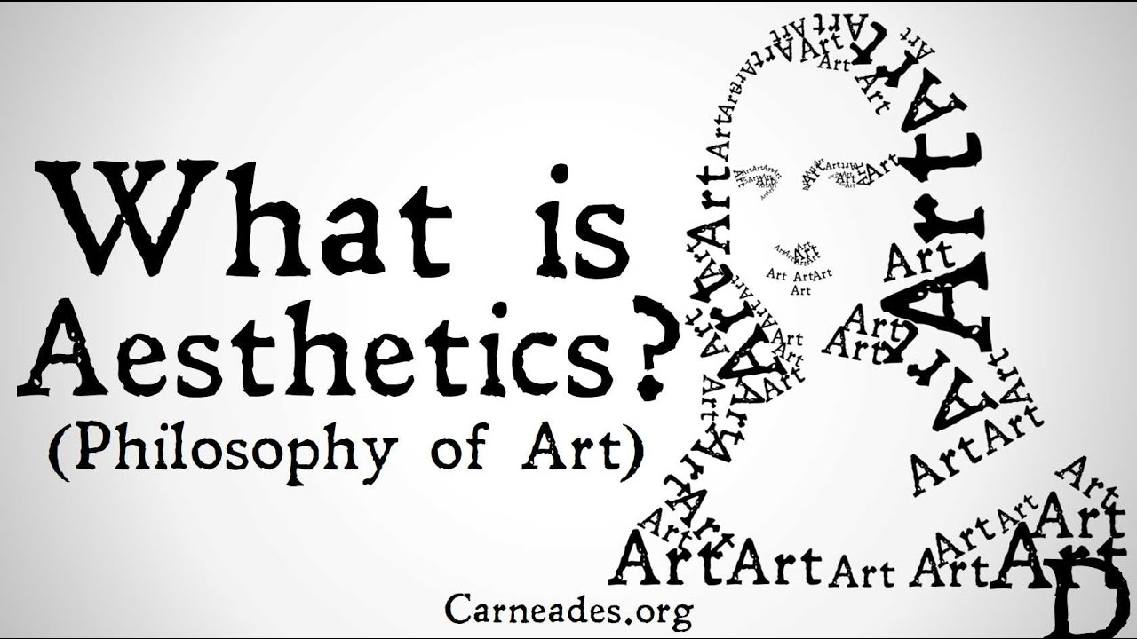
Art and the Idea of Beauty
Aesthetics refer to our sense of what is beautiful and vary across cultures over time.

Slide 4
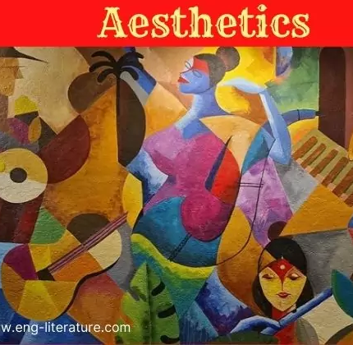
Art is something we do! Art is an expression of our thoughts, emotions, intuitions, and desires.

Slide 5
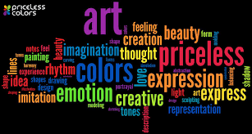
What aWhat are the visual arts?
The visual arts are art forms such as painting, drawingWhat are the visual arts?
The visual arts are art forms such as painting, drawing, printmaking, sculpture, ceramics, photography, video, filmmaking, design, crafts and architecture., printmaking, sculpture, ceramics, photography, video, filmmaking, design, crafts and architecture.re the visual arts?
The visual arts are art forms such as painting, drawing, printmaking, sculpture, ceramics, photography, video, filmmaking, design, crafts and architecture.

Slide 6
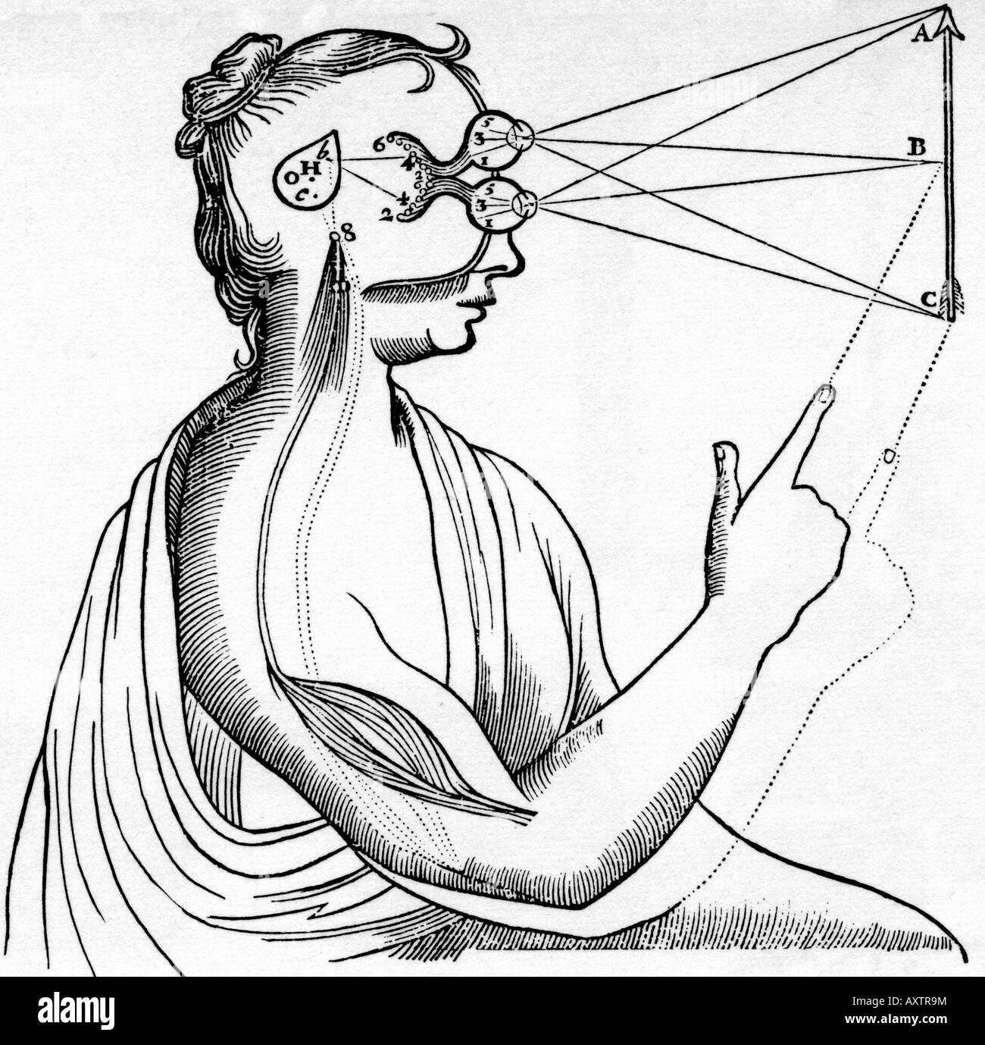
The Process of Seeing
Visual processing can be divided into reception, extraction, and inference.
  The human retina "edits" information from external sources.
One of the basic ways of seeing is through linear perspective which is a process that anyone can embrace invented during the Italian Renaissance.

Slide 7
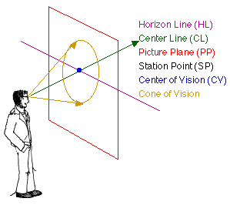

Slide 8
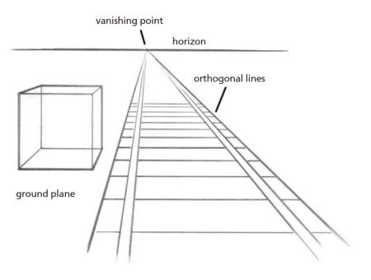
Artists use this drawing procedure to serve their own creative vision to provide illusionistic depth perception. The legacy of this 607-year-old technique, structures how we really see and perceive the world from our binocular vision and station viewing points .

Slide 9
The One-point Perspective Drawing Process
One point perspective is composed of three components:
A horizon line
Converging or orthogonal lines leading to…
A vanishing point
This type of perspective requires the viewer to be placed in a station point relative to their view. The diagram on the right, illustrates our cone of vision revealing these basic aspects. The next slide shows the following photographs composed by me revealing the same pathway near the Missouri river in Kansas City, MO.:

Slide 10
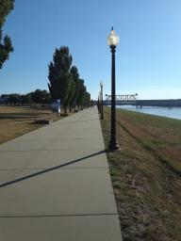
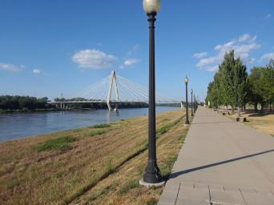
The vanishing point is in the center of the vertical image and located approximately 2/3 from the bottom of the left photograph. Note that the riverbank evenly spaced lampposts and planted trees all converge to a vanishing point in the distance from a standing station point view.
In the second horizontal photograph, the vanishing point is located center right. The river follows the path to the right until it curves to the left in the distance. The front lamppost blocks the curve view.
The horizontal photograph provides a wider angle and spatial view of this landscape while still conveying one point perspective. Note that the lampposts, trees and shadows all appear to recede into the distance. Remember that this is an illusion. When viewed from the side, all these objects are of the same size. It is the direction of viewing a scene and our individual station point which provides the depth perception gotten through linear one point perspective.

Slide 11
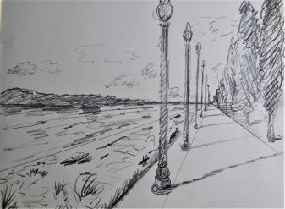
Here we see a photographic reference image and gesture sketch taken and drawn by me depicting a horizon line, vanishing point and converging lines.
One point perspective reference photograph.
One point perspective gesture sketch.

Slide 12
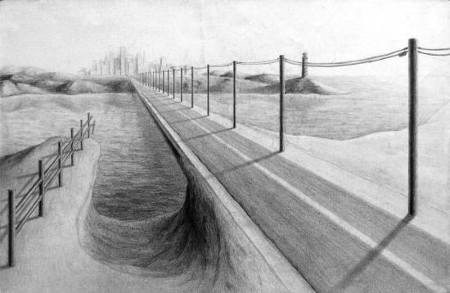
A drawing begins with a loose gesture sketch which can advance toward a state of finish, seen in this student drawing of a roadway.

Slide 13
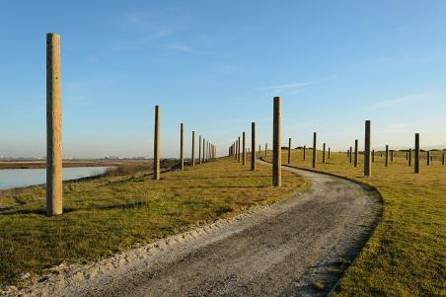
In this photograph we can clearly see one point perspective combining in a more complex image including hard edge objects (posts)and an S curve road receding in the distance. Here we see multiple one-point perspectives.

Slide 14
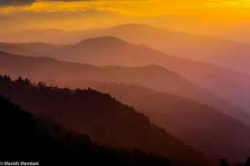
Yet another way we naturally see is via value/tonality as seen in this photograph of a mountain vista. We refer to this as atmospheric perspective:

Slide 15
The Near and the Far
Japanese prints that flooded European markets after 1853 combined close-up views of nearby objects with views of distant landscapes.
Utagawa Hiroshige's Moon Pine, Ueno contains a large gap between the pine in the foreground and the city behind.
This particular tree was named for its looping round branch.

Slide 16
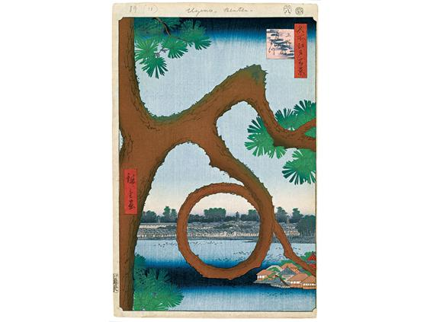
Utagawa Hiroshige (Ando), Moon Pine, Ueno, No. 89 from One Hundred Famous Views of Edo.
1856. Woodblock print, 14-3/16 × 9-1/4". The Brooklyn Museum.
Gift of Anna Ferris, 30.1478.89. [Fig. 4-23]

Slide 17
The Creative Process
Artists engage in critical thinking:
  They respond to the unexpected, chance occurrences and are open to new ways of thinking.
  The artist manages the process from seeing to imagining to making, becoming self-critical and exploring the possibilities of their work.
  Other world cultures are usually collective, rather than individually oriented, such as residents of Saipan, I have had the pleasure of teaching. They are Pacific Islanders with two distinct cultures and language known as Chamorro and Carolingian. The Northern Marianas islands are situated in the Pacific Ocean, named by Spanish explorer Ferdinand Magellan.

Slide 18
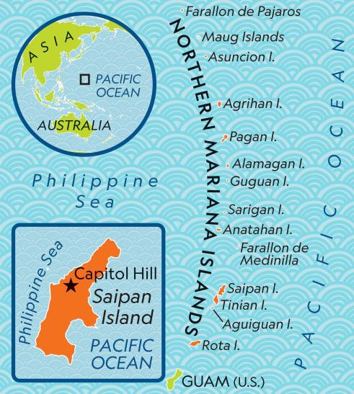

Slide 19
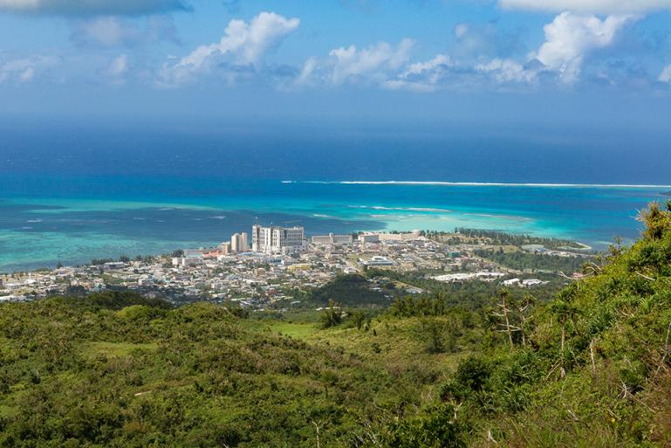

Slide 20
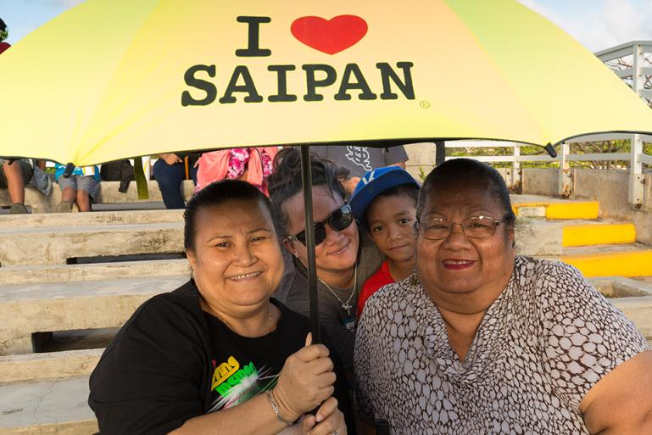

Slide 21
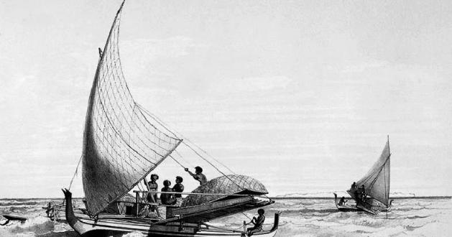
The Proa boat was is a unique sailboat which originated in Polynesia. Many different Polynesian people groups populated and traded amongst other islanders of Oceana, a region made up of thousands of islands throughout the Central and South Pacific Ocean. This boat is an example of form(outward appearance) and function ( this boat allowed used the power of wind and currents).

Slide 22
Art and the Idea of Beauty
Aesthetics refer to our sense of what is beautiful and vary across cultures over time.
What we in the west regard as beautiful other cultures have different philosophies and may in fact regard what we think as beautiful to be ugly
Western culture values order, regularity, proportion, and design, which are hallmarks seen through Classical art and architecture. Eastern cultures value tradition, intuition, respect for elders.
Far east traditional painting is characterized by water-based techniques, less realism, “elegant” and stylized subjects, graphical approach to depiction, the importance of white space (or negative space) and a preference for landscape (instead of the human figure) as a subject.

Slide 23
Roles of the Artist: Truth Telling
Artists help us see the world in new or innovative ways.
  Prior to his work, Ken Gonzalez-Day researched the history of lynching in California, finding Native Americans, Chinese immigrants, and Latinos were lynched more than other groups.
  Art can show outrageous acts of violence against other humans. Thus, photography and camera arts such as film explore our human condition both the good and bad.

Slide 24
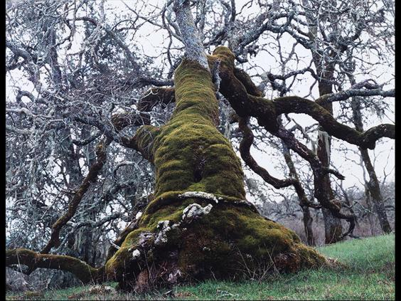
Ken Gonzales-Day, "At daylight the miserable man was carried to an oak…," from the series Searching for California Hang Trees.
2007. Chromogenic print, 35 × 45". Smithsonian American Art Museum, Washington, D.C.
Museum purchase through the Luisita L. and Franz H. Denghausen Endowment, 2012.12.1. © 2015. Digital image, Smithsonian American Art Museum, Washington, D.C./Scala, Florence. © 2015 Ken Gonzales-Day. [Fig. 1-16]

Slide 25
Roles of the Artist: Architecture
Artists make functional objects and structures (buildings) more pleasurable and elevate them or imbue them with meaning.
  Public space features standards of aesthetic beauty.
  Self-sufficiency, sustainable building materials, and suitability to climate and culture exemplify "green architecture.“
  Architects must be sensitive to the environments in which they build in order to honor the surrounding culture. It would be senseless to build a skyscraper in the middle of a dense forest.

Slide 26
Artists make functional objects and structures (buildings) more pleasurable and elevate them or imbue them with meaning.
  The Jean-Marie Tjibaou Cultural Center, named for a leader of the Kanak people, features buildings of wood and bamboo.
    Architect Renzo Piano utilized the nearby ocean breeze in a design that cooled the inner rooms of the pavilions.

Slide 27
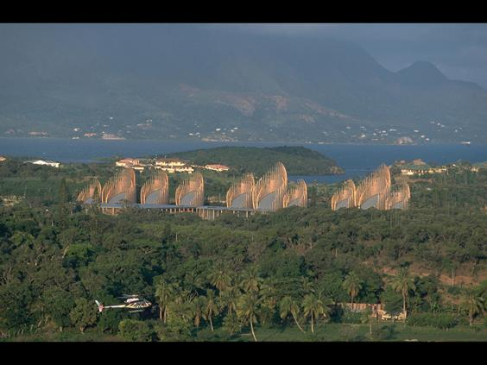
Renzo Piano, Jean-Marie Tjibaou Cultural Center, Nouméa, New Caledonia.
1991–98.
© Giraud-Langevin/Sygma/Corbis. [Fig. 1-18]

Slide 28
Roles of the Artist :Believed, but not seen (Faith/Religion/Spirituality)
Artists give form to the immaterial—hidden or universal truths, spiritual forces, personal feelings.
  Western approach to works from African, Oceanic, Asian, or Native American cultures often relegates everyday objects to "works of art.“ In fact, there is no word for art in Native American tribal culture as there was none in ancient Greece.
  The only word was the Greek word techne which referred to something well made. We derive our word technology from this term.

Slide 29
Roles of the Artist
Artists give form to the immaterial—hidden or universal truths, spiritual forces, personal feelings.
  Images of God were protested through Western history due to the injunction that God the father is spirit and cannot be seen. Jan van Eyck depicted a frail, young, merciful, and richly adorned God in his Ghent Altarpiece.
  Christ was the exception to this as we have numerous depictions of the God-Man.

Slide 30
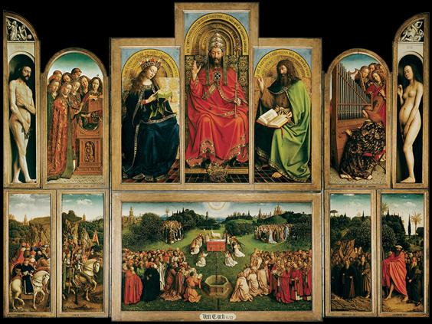
Jan van Eyck, The Ghent Altarpiece. ca. 1432. Oil on panel, 11' 5" × 15' 1". Church of St. Bavo, Ghent, Belgium.
© 2015 Photo Scala, Florence. [Fig. 1-21]

Slide 31
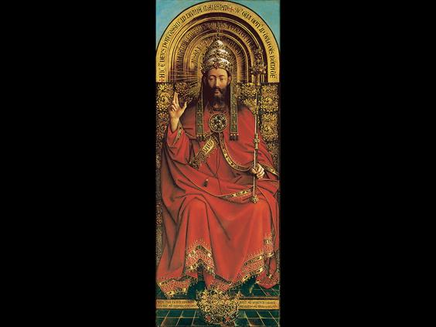
Jan van Eyck, God, panel from The Ghent Altarpiece. ca. 1432.
© 2015 Photo Scala, Florence. [Fig. 1-22]

Slide 32

Here we have a photo image of Christ painted on a wall to lend yet another art form we refer to as public art(murals), seen by numerous persons in the open air.

Slide 33
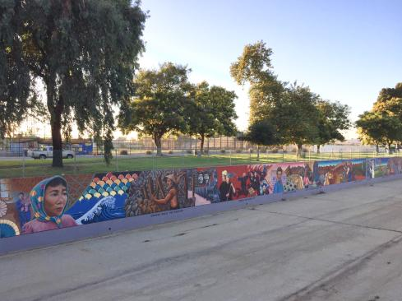
Another mural is the public artwork painted in 1974 organized by Dr. Judith Baca.
The Great Wall of Los Angeles (also known as The History of California) is a half-mile long mural depicting the history of California through images of significant figures and historic events from diverse and traditionally marginalized communities.

Slide 34
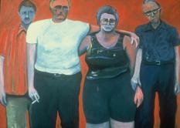
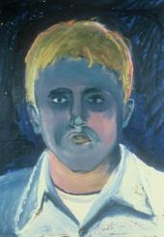
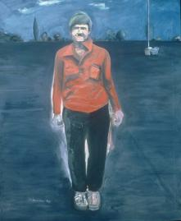
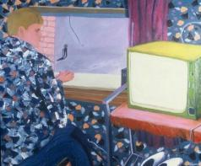
Part of my personal creative work was a representation of mentally challenged persons who have been marginalized in our society. I had a mentally challenged brother who was the well spring of my personal body of work. My focus was to bring attention to the plight of these individuals in a series entitled: “Tom’s World.”

Slide 35
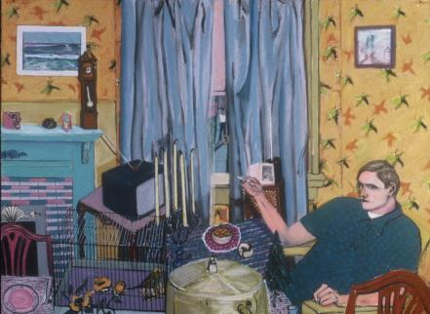
In summary, visual art provides a rich dimension to the human viewing experience. Art stops us in our tracks to contemplate our human condition!
Artists bring to our attention atrocity, joy, pain, wonderment and a whole host of emotions.
They challenge us using a variety of media to contemplate ourselves in the process of seeing.

