Slide 1
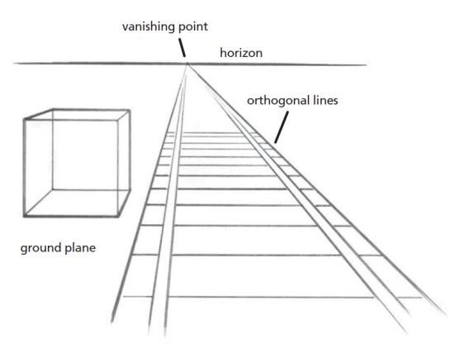
_________________
The Art of the Italian Renaissance
A teaching demonstration by
David E. Harmon

Slide 2

A brief definition and history:
I want to start my lecture by discussing the single most important art technique invented during the Italian Renaissance, i.e., one-point Linear Perspective. It is defined as “parallel lines converging to a single point on a horizon line ,referred to as the vanishing point.”. The Italian Renaissance was a period of great discovery drawn from the classical Graeco-Roman past as seen in the columns to the right.It may be categorized as early, high and late Renaissance or the Mannerist period from 1425-1525 CE. It incorporated linear perspective theory enabling its painters to paint realistic portraits and architects to plan accurately rendered cities with buildings seen in accurate perspective. The availability of paper gotten from book publishing (classical knowledge was flourishing), afforded artists the ability to draw recording their visions. Leonardo made many drawings on paper. I have taken 9 overseas trips to Europe with college students. I feel students need to physically see the art works they have studied in art museum visits. In 2000, my students and I visited Pompeii, Italy and viewed many fresco paintings. Fresco or fresh is a mural technique, whereby, water-based pigments are applied directly to wet plaster walls.
One example is in the following slide:

Slide 3
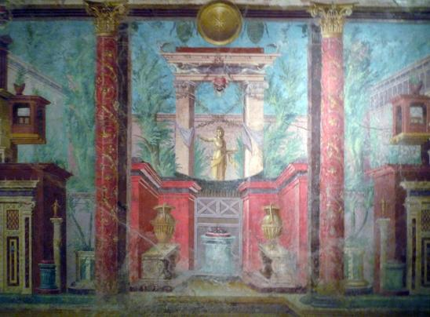
Here, we see an attempt to provide one point perspective illusion painted in 50-40 BCE of an interior setting in the bedroom of a Villa, located in Pompeii, Italy.
The villa was buried in ash and preserved from the 79 CE eruption in Pompeii. The heat of the volcanic ash effectively sealed the painting in a glass like coating!

Slide 4
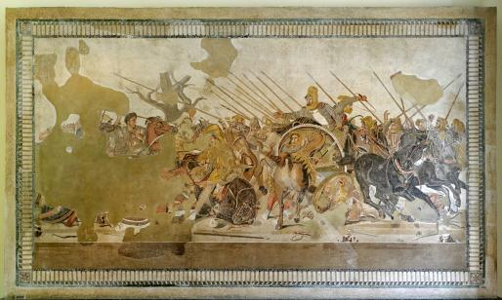
Scholars speculate that the ancient Greeks may have discovered perspective, passing this knowledge to the Romans.
The image to the right shows Battle of Issus ,in Roman mosaic (colored glass/stone).Created in 100 BCE in Naples, Italy, it depicts Alexander the Great in battle with foreshortened horses galloping toward the viewer and a ground plane set in realistic space!

Slide 5
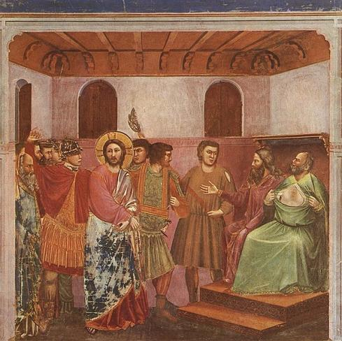
Early Italian Proto-Renaissance painter, Giotto di Bondone (1267-1337 CE) is considered the father of linear perspective with his window opened to the world technique. His painting Jesus before the High Priest Caiaphas was painted in 1305 for the Scrovegni Chapel in Padua, Italy.

Slide 6

This painting reveals ceiling rafters.
These appear as converging lines receding in implied believable space existing beyond the wall. This image opened the interior viewing space of walls and floor planes, providing the illusion of depth perception. The artist used observational logic to paint this convincing image .

Slide 7
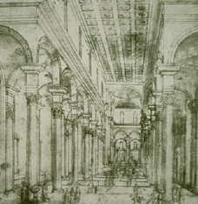
The first drawing of one-point linear perspective was created by the Florentine and early Italian Renaissance architect Filippo Brunelleschi (1377-1446 CE). Drawn on paper in 1415 CE, it depicted, in true linear perspective , the Baptistery in Florence, Italy. Brunelleschi needed a drawn reference before he could design his buildings and thus invented linear perspective. It became that great discovery developed through mathematics and reason from observation. We can see columns appearing smaller in size as they recede in space.
Perspective provides the illusion of depth perception on a flat surface such as paper and canvas.

Slide 8
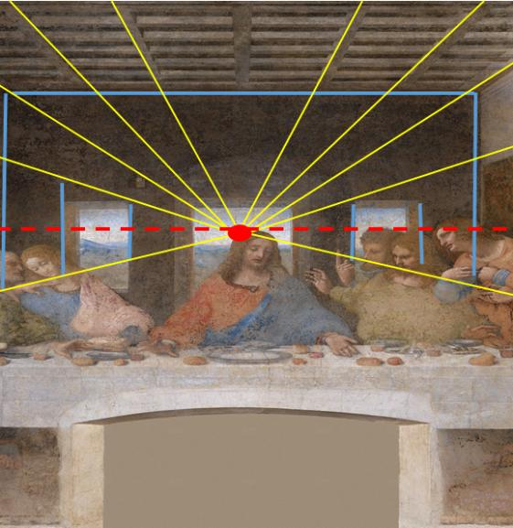
Leonardo Da Vinci’s fresco wall mural painting of The Last Supper was painted over a three-year period from 1495 to 1498 CE in the High Renaissance period. It is a classic example of one-point perspective replete with a vanishing point, horizon line and several converging lines centering on the head of Christ as the vanishing point. There is even a background landscape set in aerial perspective adding even greater spatial depth.

Slide 9
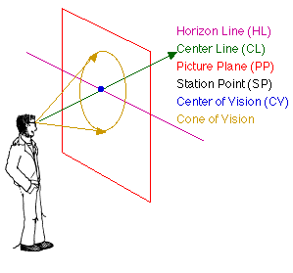
The One-point Perspective Drawing Process
One point perspective is composed of three components:
A horizon line
Converging or orthogonal lines leading to…
A vanishing point
This type of perspective requires the viewer to be placed in a position relative to their station point view. The diagram on the left, illustrates our cone of vision revealing these basic aspects. The next slide shows the following photograph and drawing composed by me revealing a one-point perspective of streetlamps placed alongside a riverbank and sidewalk:

Slide 10
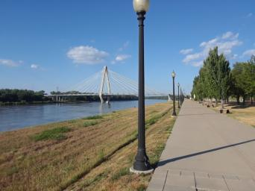
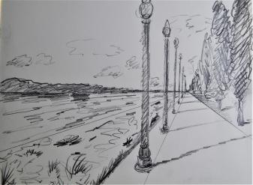
Here we see my photographic reference image and my sketch. It depicts a horizon line, vanishing point and converging lines. While physical distance between each post is identical, the visual gap between consecutive posts appears smaller further away in the distance. Perspective provides an illusion of depth with our binocular vision.

Slide 11
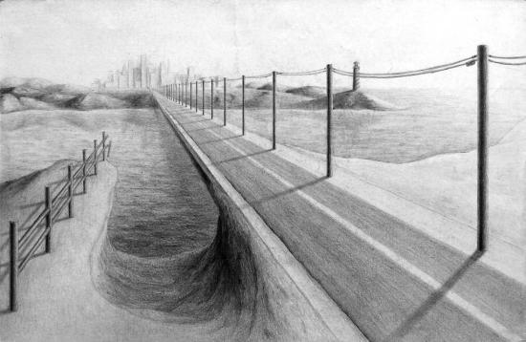
One of my students created this drawing .A drawing begins with a loose gesture sketch which can advance toward a state of finish.

Slide 12
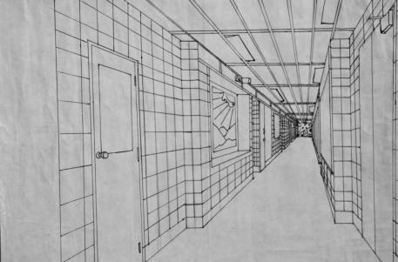
Another student drawing, reveals a long interior hallway image leading the eye toward a vanishing point in the distance using several converging lines. The floor plane, ceiling panels and tile walls all recede in space, providing the illusion of depth.

Slide 13
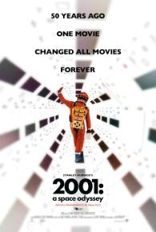
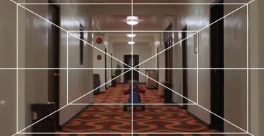
Filmmaker Stanley Kubrick used one-point perspective theory in films such as…
2001: A Space Odyssey (1968)
The Shining (1980)

Slide 14
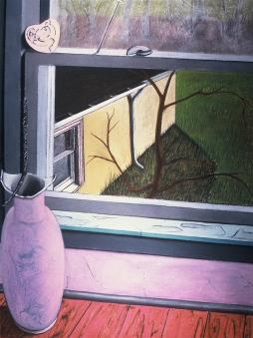
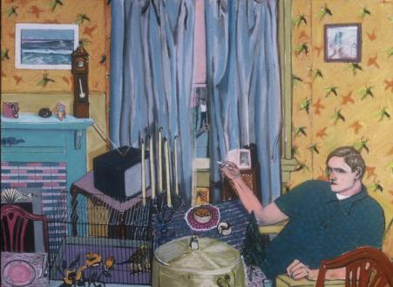
I have used one point perspective in both my pastel drawings and paintings. In some images, one-point perspective is implied by angles rather than clearly seen. My other art works are more obvious such as the following two paintings of a wall and railroad track:

Slide 15
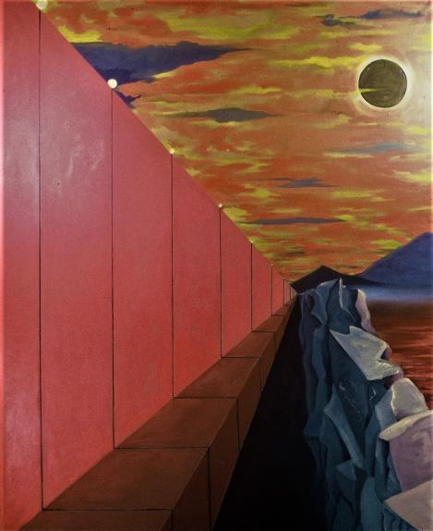
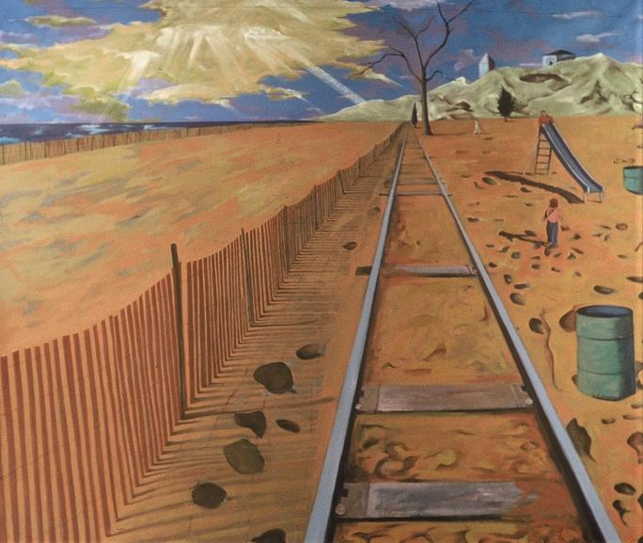

Slide 16
In conclusion, artists learn Italian Renaissance one-point linear perspective technique. They use this drawing procedure to serve their own creative vision and to provide illusionistic depth perception. The legacy of this 611-year-old technique, structures how we really see and perceive the world using our binocular vision. It is utilized across many art media including drawing, painting, film and digital applications.

