Slide 1
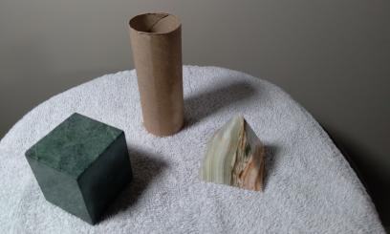
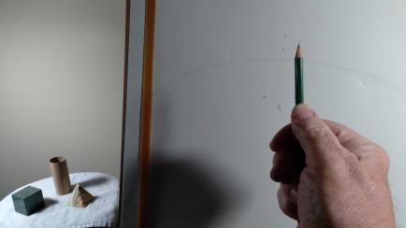

Learning How Artists Draw: A Sight Measuring Drawing Technique for Drawing 1
A Demonstration
by David Edward Harmon

Slide 2
The Process of Seeing
Visual processing can be divided into reception, extraction, and inference.
The human retina "edits" information perceived from external sources.
Seeing is inherently creative, as you decide what details are important-artists see both the whole and parts.
In the Italian Renaissance ,drawing came to be considered an art in its own right. Artists became known as geniuses, as drawing revealed their visual concepts and processes directly using drawings on paper. Observation from nature was documented in sketchbooks made by artists.

Slide 3
The Creative Process
Artists engage in critical thinking.
They respond to the unexpected, chance occurrences and are open to new ways of thinking.
The artist manages the process from seeing to imagining to making, becoming self-critical and exploring the possibilities of their work. Drawing is essential in this process.

Slide 4
From Preparatory Sketch to Finished Work of Art
Through drawing, artists can illustrate different approaches to compositions.
It is useful in its directness as well as its ability to record visual history.
Today, drawing may be viewed as an activity accessible to both artists and ordinary people. I encourage my students to draw what they see rather than what they think they see!
Paper was not manufactured in the West until the thirteenth century and was preceded by papyrus in Egypt and parchment in ancient Rome.
The publication of books aided artists access to paper especially during the Renaissance period in the 1400’s

Slide 5
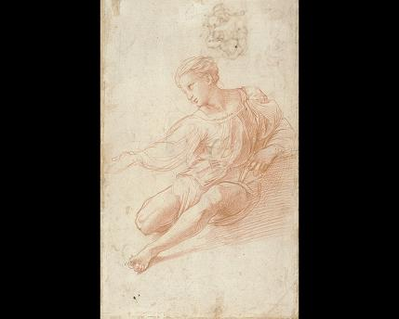
The Creative Process in Drawing
In the drawn studies for The Alba Madonna, early 1500’s, Raphael worked on both sides of a single piece of paper.

Slide 6
The drawing media we will use for this project is Graphite. Historically…
Lead pencils became increasingly popular after black chalk became harder to find in the sixteenth century.
Originally, graphite sticks were wrapped in string. Later, the graphite was inserted into hollowed-out wooden sticks and, thus, the wood-cased pencil was born!
Nuremberg, Germany was the birthplace of the first mass-produced pencils in 1662. Spurred by Faber-Castell (established in 1761), Lyra, Staedtler and other companies, birthed an active pencil industry developed throughout the 19th century industrial revolution.

Slide 7
How Can we accurately Draw What we See?
One method is referred to as sight measuring.
As defined: Sight-Size or sight measuring is an arrangement of the artist, their subject and their artwork that allows the artist to see the subject and artwork visually on a one-to-one basis.

Slide 8
Three important concepts which you will experience :
>Sight-Size is simply an arrangement of the artist, subject and artwork that allows the artist to see their subject and artwork one-to-one. When in Sight-Size, the size you see the subject is the size you draw, paint or sculpt it.
>Your vantage point must be far enough away for you to see both your subject and artwork in one glance.
>Due to the above, Sight-Size allows you to accurately represent a given subject in the same way your eye sees it.

Slide 9
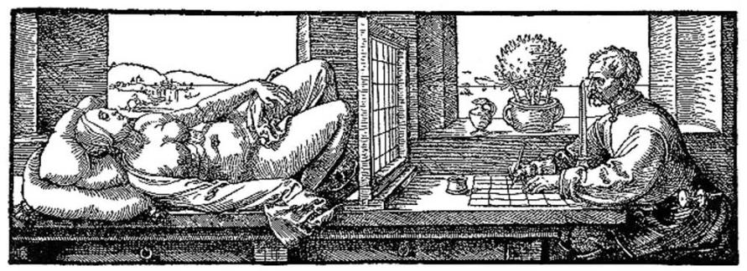
German artist Albrecht Durer developed a grid system in order to help artists faithfully draw what they were seeing. The following is an etching(print) he made in 1525:

Slide 10
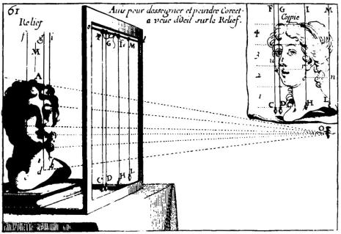
In 1665, French artist and theoretician, Abraham Bosse wrote a book entitled Practical Geometry and Perspective. It helped artists use a drawing system in order to draw accurately from life.

Slide 11
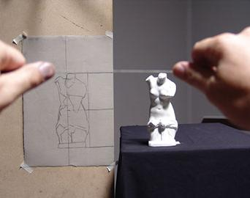
As defined, Sight-Size is a method of drawing an object exactly as it appears to the artist. It is done on a one-to-one scale. It was developed in the 19th century. The rules are strict and it builds your ability to see, replicate and render objects from direct observation. It is a technique that is used widely in many workshops/ateliers in Florence to copy ancient sculpture.

Slide 12
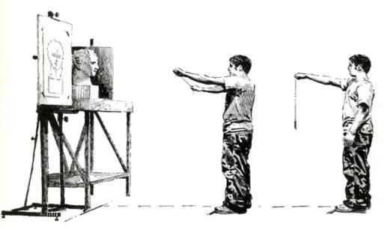
In the 21st Century, art students can utilize time honored methods for sight measurement technique gaining accuracy, but not necessarily exact copies, as creative expression becomes more liberating. I will use this concept accordingly.

Slide 13
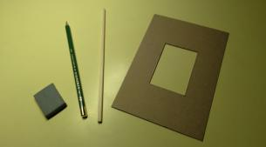
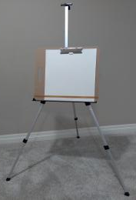
Drawing materials and tools:
One kneaded eraser
2 B Drawing Pencil(s)
An alignment tool (skewer stick/chop stick)
A Viewfinder(2”x 3” window cut out)
Standard 80 lb. Drawing paper
An easel
One drawing board

Slide 14
The Sight Measuring Drawing Procedure
Set up your 3 objects on a stand with white paper or cloth underneath
Position your objects to provide an effective composition
Set up studio lights to illuminate your objects to create shadows thus providing 3-D illusion
Take your viewfinder to check the objects positioning and space between each object

Slide 15
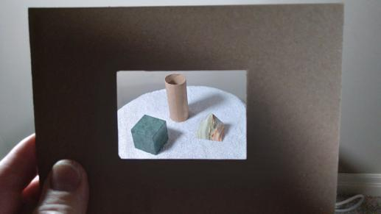
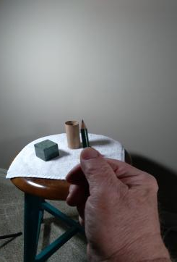
Use a Viewfinder to Determine your Overall Composition. Use your pencil to sight measure each object angle.

Slide 16
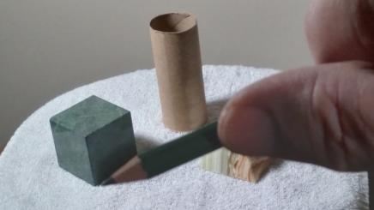
On your paper, lightly place dots to locate edges. These can be connected later much like children’s connect the dots picture sheets, but without numbers .Continue using your pencil to locate angles and draw them accordingly.

Slide 17
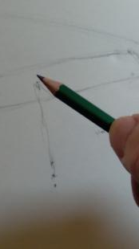
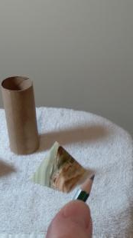
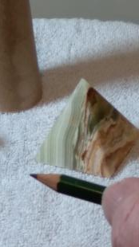
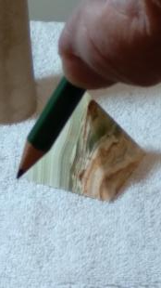
Some angles can be challenging to draw. Therefore, you will want to use a gestural approach and draw your lines lightly. You can correct/erase these later.

Slide 18
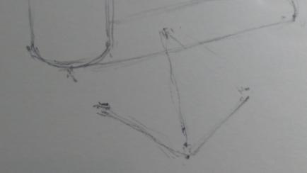
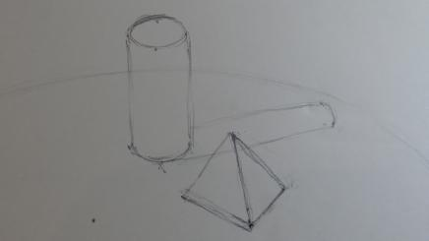
The dot technique is used throughout the drawing. Dots are connected to reveal objects. Don’t be afraid to draw right through the shapes like an x-ray, so you may see where they are located in the composition.

Slide 19
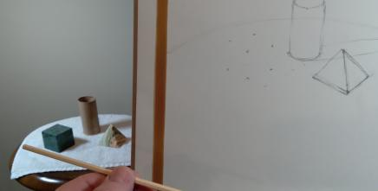
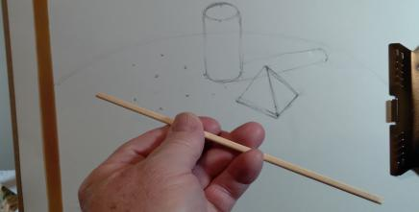
At this stage, the composition is emerging. A skewer/chop stick can be helpful as an alignment tool. In the following images, you can see the still life object angles. Here, shape location and relationships are the key to a successful drawing.

Slide 20
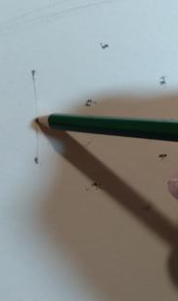
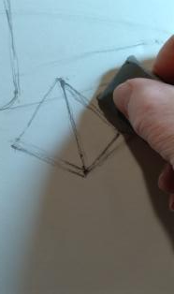
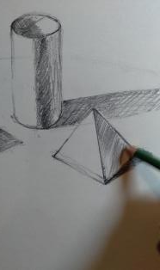
Additional Objects are drawn. The eraser is used to clean up/correct drawn edges. Hatching lines can be added on the objects and their respective shadows to create values for 3-D shape illusion.

Slide 21
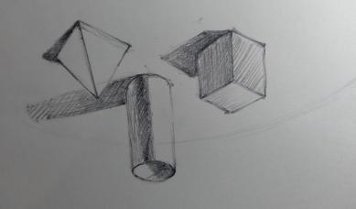
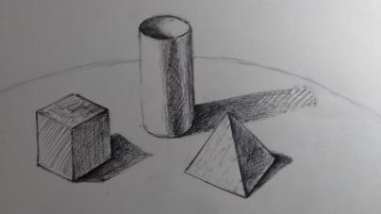
Final approaches can include, turning the drawing upside down to check the composition and correct/erase as needed. As you can see, the sight measuring technique is a fundamental procedure to insure an accurate yet expressive drawing.

Slide 22
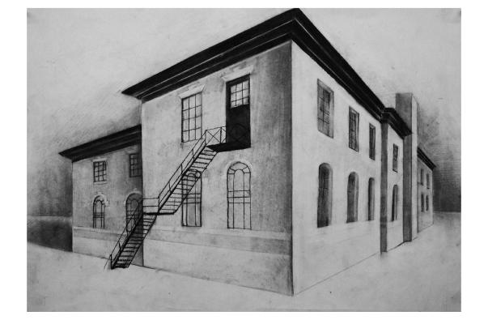
The following slides are those of my completed student's work in drawing 1 and 2.The use of sight measuring to determine effective composition was incorporated along with other drawing techniques. In this slide, the student drew a building using charcoal and sight measuring to ensure proper alignment of edges and angles to reveal two-point perspective >

Slide 23
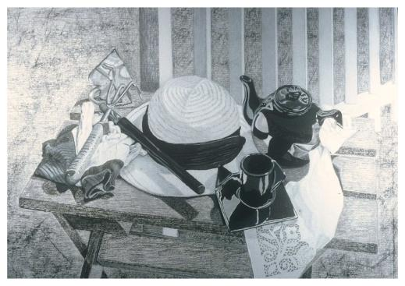
This is a slide of a personal still life composition the student had set up outdoors. Sight measurement was essential to ensure that each object was placed at proper angles in relation to one another. >

Slide 24
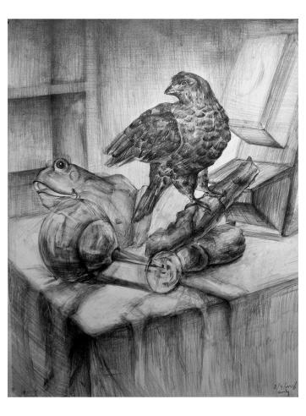
This slide was part of a classroom set up of miscellaneous objects. Students were required to create a finished drawing. The compositional relationship among objects was ensured once again by sight measurement >

Slide 25
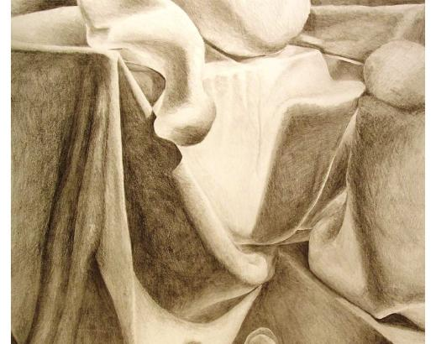
This slide is a close-up of a graphite drapery fold project revealing strong angular shapes. The shapes are organic yet require sight measuring technique to provide an effective composition.>

Slide 26
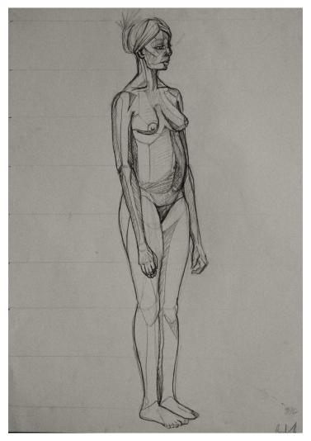
In my figure drawing class sight measurement techniques are used along with planar analysis. In this standing female nude drawn from life observation, various anatomical parts have been measured and drawn to scale.>

Slide 27
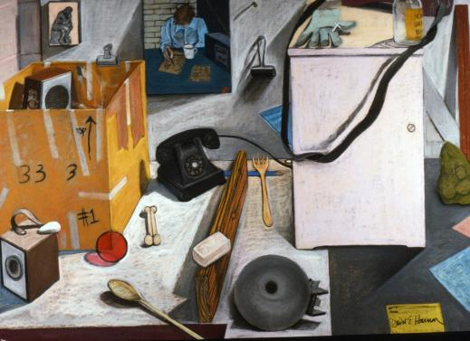
The following slides were part of my still life series including both interiors and still life objects which were drawn using sight measuring. All objects were set up by me and drawn from direct observation. The medium is dry pastel on paper,30” x 40” in size.>

Slide 28
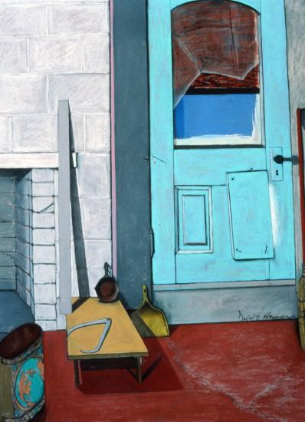

Slide 29
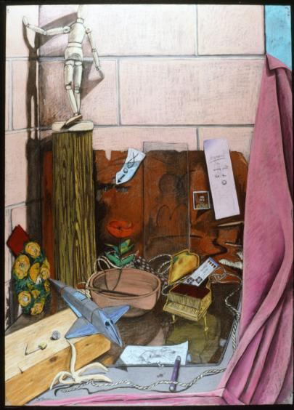

Slide 30
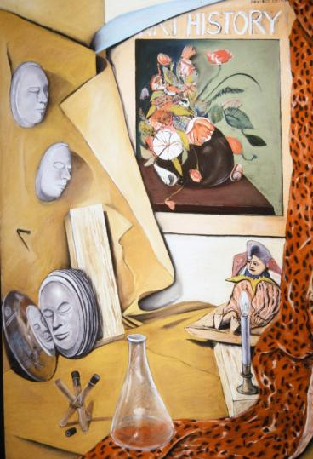

Slide 31
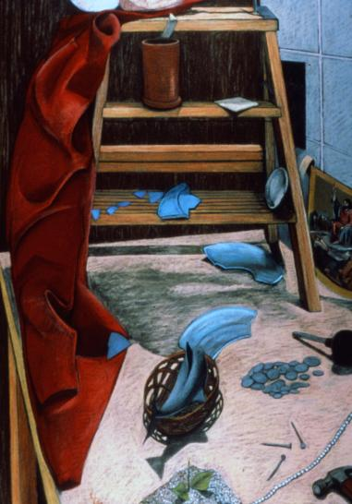

Slide 32
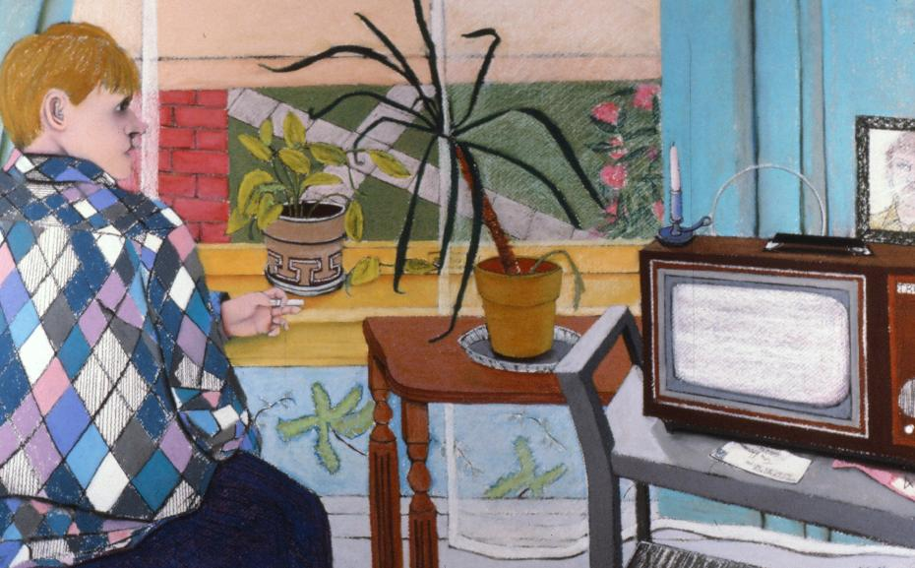

Slide 33
In conclusion…
I trust that you will have a pleasing drawing experience. Drawing requires practice. Skills can be shaped accordingly. In short, draw what you see rather than what you think you see. We all draw from what painter Willem DeKooning I had interviewed had described as a slipping glimpser: “Content, if you want to say, is a glimpse of something, an encounter, you know, like a flash—it’s very tiny, very tiny, content.” After you have studied objects, persons and landscape, you can feel confident in visually documenting what you see using your own individual expression. Sight measuring is a time-honored technique in order to measure and record what we truly see. It is also recorded memory as we observe, look away, draw and look again. This is how most successful artists draw!

