Slide 1
George Inness and Richard Mayhew:
American landscape painters of the 19th through 21st century
Realism vs. Color Consciousness

Slide 2
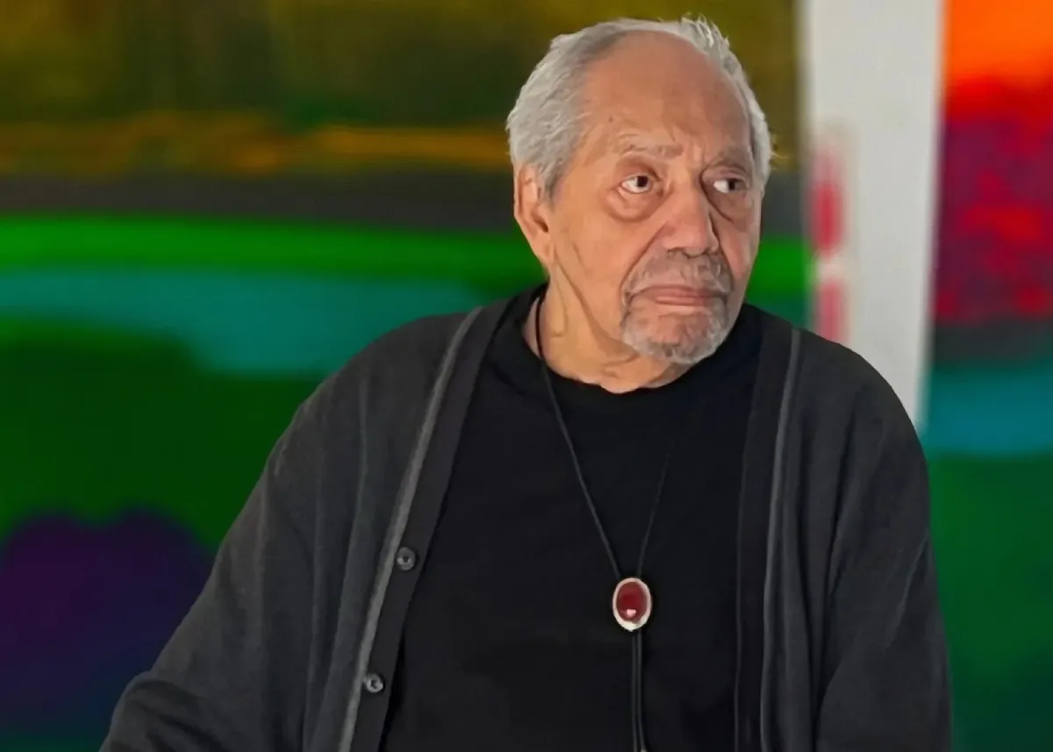
Comparanda(to compare): The painters and their respective visions
George Inness,1825-1894
Richard Mayhew,1924-2024

Slide 3
Artist Quotes… Different visions
The purpose of the painter is simply to reproduce in other minds the impression which a scene has made upon him. A work of art does not appeal to the intellect. It does not appeal to the moral sense. Its aim is to instruct, not to edify.
George Inness
What I do with landscapes is internalize my emotional interpretation of desire, hope, fear, and love. I don’t attempt to mimic the land but to use it as a metaphor. I am both African and Native American. This is why I paint landscapes. Their blood is in the soil of the United States. So, instead of a landscape, it’s a mindscape.
Richard Mayhew

Slide 4
We will now discus two works of art using comparanda by two landscape painters:
Medford,MA.1885,oil on canvas,20” x 31”, by George Inness
Sante Fe Trail,1999, oil on canvas,40” x 48” by Richard Mayhew

Slide 5
I have personally viewed both paintings. The St. Louis Art Museum (I am originally from St. Louis) owns the Inness painting. The Mayhew work is owned by a private collector. I had interviewed Mayhew in his studio in California on three different occasions. Richard was my main graduate mentor at Penn State University. He acknowledged his Inness influence. However, his departure from Inness and the impressionists for that matter, was in his embrace of Abstract Expressionism and color field painting from the 1950’s through the 1960’s.

Slide 6
George Inness was a 19th century white painter of a movement called tonalism. He also believed in a system of philosophy referred to as Transcendentalism, developed by Immanuel Kant. It is based on the idea that, to understand the nature of reality, one must first examine and analyze the reasoning process which governs the nature of experience. This artistic movement was based on a realistic approach to painting. Artists used realistic imagery, yet they softened and subdued the color tones of their palette to suggest depth or atmospheric perspective.
.

Slide 7
Richard Mayhew, on the other hand ,was a 20th through 21st century painter with both African American and Native American heritage. Mayhew’s approach is less realist based and concerned more about how color affects the eye and mind, in terms of afterimages or simultaneous contrast.
Notes:
If you stare at the green square with the black background for about 30 seconds and look at the white area to the right , you will see a floating opposite or complementary color generated.

Slide 8
Differences: Inness was self taught, whereas Mayhew studied with great American painters such as Edwin Dickinson, Hans Hofmann, Yasuo Kuniyoshi and Rubin Tam. Inness was locked into a tonalist mindset which demanded a stylistic approach based on specific locales he had seen on location when painting outdoors or En plein air. Mayhew sketched and absorbed his study of the land in relation to his belief of a universal landscape he refers to as a mindscape. Thus, all of his life experiences coalesce or come together in his painting process. Memories and Color theory and application were the most important elements for Mayhew, as colors are always in flux or change as one views each painting.
Here, Mayhew stands next to an untitled painting at age 95.To quote:
…But the influence of place and environment and community play into the creative consciousness. The unique sensibility of the creative mind-set, is an important quality. For me, ethnicity is more about emotional interpretation than identifying with a particular place. My mindscapes are also about the healing of that long trauma that the black and native communities have experienced collectively…

Slide 9
Mayhew had also alluded to his interest in a scientific approach regarding the phenomena of simultaneous contrast or after image. It is well known that French Impressionist painters such as Georges Suerat were influenced by Michel Chevreul, a French chemist, who lived from1786-1889.
Here, Chevreul’s color model represented the complete range of shades, tones and tins of every hue, but his concept of tone confounded lightness (value) and saturation. Chevreul identified a fundamental law of the simultaneous contrast of colors which detailed the effects that proximity between two colors has on what the eye sees.

Slide 10
In conclusion, both American artists used landscape as subject matter, painted in oil on canvas , yet had different approaches regarding composition , painting sizes, the element of color (realistic ,detailed and mostly small format for Inness vs. acidic intense, abstract and simplistic color and large format for Mayhew).Both artists were products of their time, yet arrived at very different meanings for their respective paintings. Inness was more concerned with transcendentalism, the view that nature, including human beings, has the power and authority traditionally attributed to an independent deity. Whereas Mayhew used color as symbolic of his personal ethnicity, in that both his African and Native American’s blood is in the soil of the United States. He was also keenly aware that intense color has the power to affect our consciousness and make us aware of truly human aspects his mindscapes have on our being!

Slide 11
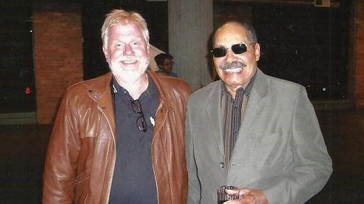
Mayhew and I at a Chicago gallery in 2005
The following is a video of Richard Mayhew in his own words…

Slide 12
https://youtu.be/LBiddIDb1Vc
https://youtu.be/OfIZAN2LJLQ?si=X5s1IUXl4zJRqB3x

