Slide 1
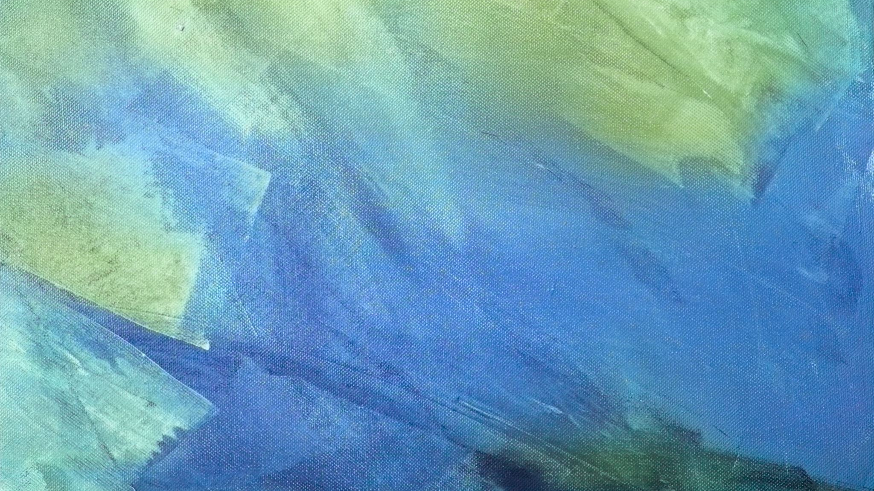
Composition in Painting: A focus on my students still life paintings in oil, painted from direct observation only
By
David Edward Harmon
Applicant

Slide 2
Artist quotes regarding composition:
It is all about composition- Paul Cezanne
And after drawing comes composition. A well-composed painting is half done-Pierre Bonnard
I have always had the feeling that thoughts, ideas and emotions can penetrate just like an arrow-they go straight through to that inner wall of composition.-Dusti Bonge
Composition, the aim of which is expression, alters itself according to the surface to be covered. If I take a sheet of paper of given dimensions, I will jot down a drawing which will have a necessary relation to its format.-Henri Matisse
I think a painter must be influenced by what he sees, all the time or even by what he conceives is around him.... I'm terribly visual minded.." -Helen Lundeberg
I can become obsessed with every mark and brushstroke on the canvas. As if every mark is a note of music and they all must come together to be coherent, like a symphonic composition – and then it will sing the song I want to sing. -Suzy Murphy

Slide 3
Thumbnail sketches like these can help you understand your selected objects and compose them in a free and gestural manner. It becomes easier to choose a final composition to paint from when you have drawn a variety of these as a practice.

Slide 4
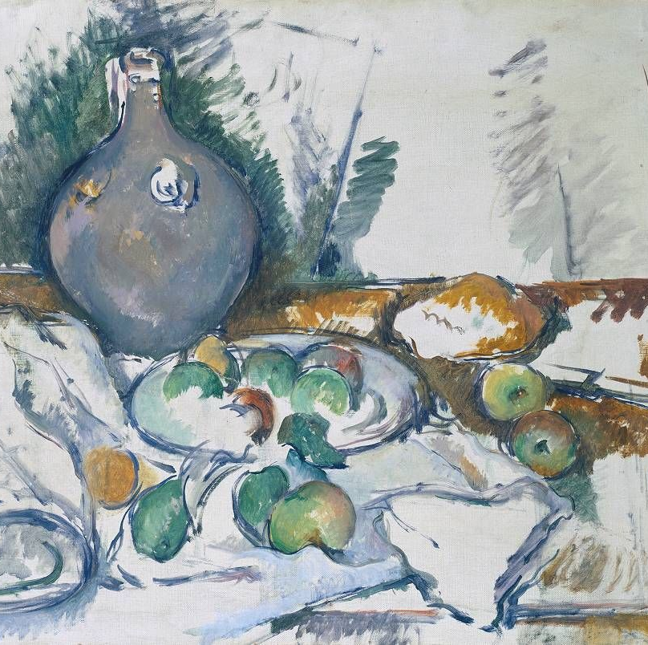
Next, you will want to sketch your selected composition in charcoal ,pencil or even oil onto your painting ground which is usually stretched canvas .The image to the right is a painting by the French Post Impressionist, Paul Cezanne, entitled Water Jug, an oil on canvas, painted in 1892. He had used this gestural approach using a brush to compose this tabletop set up.

Slide 5
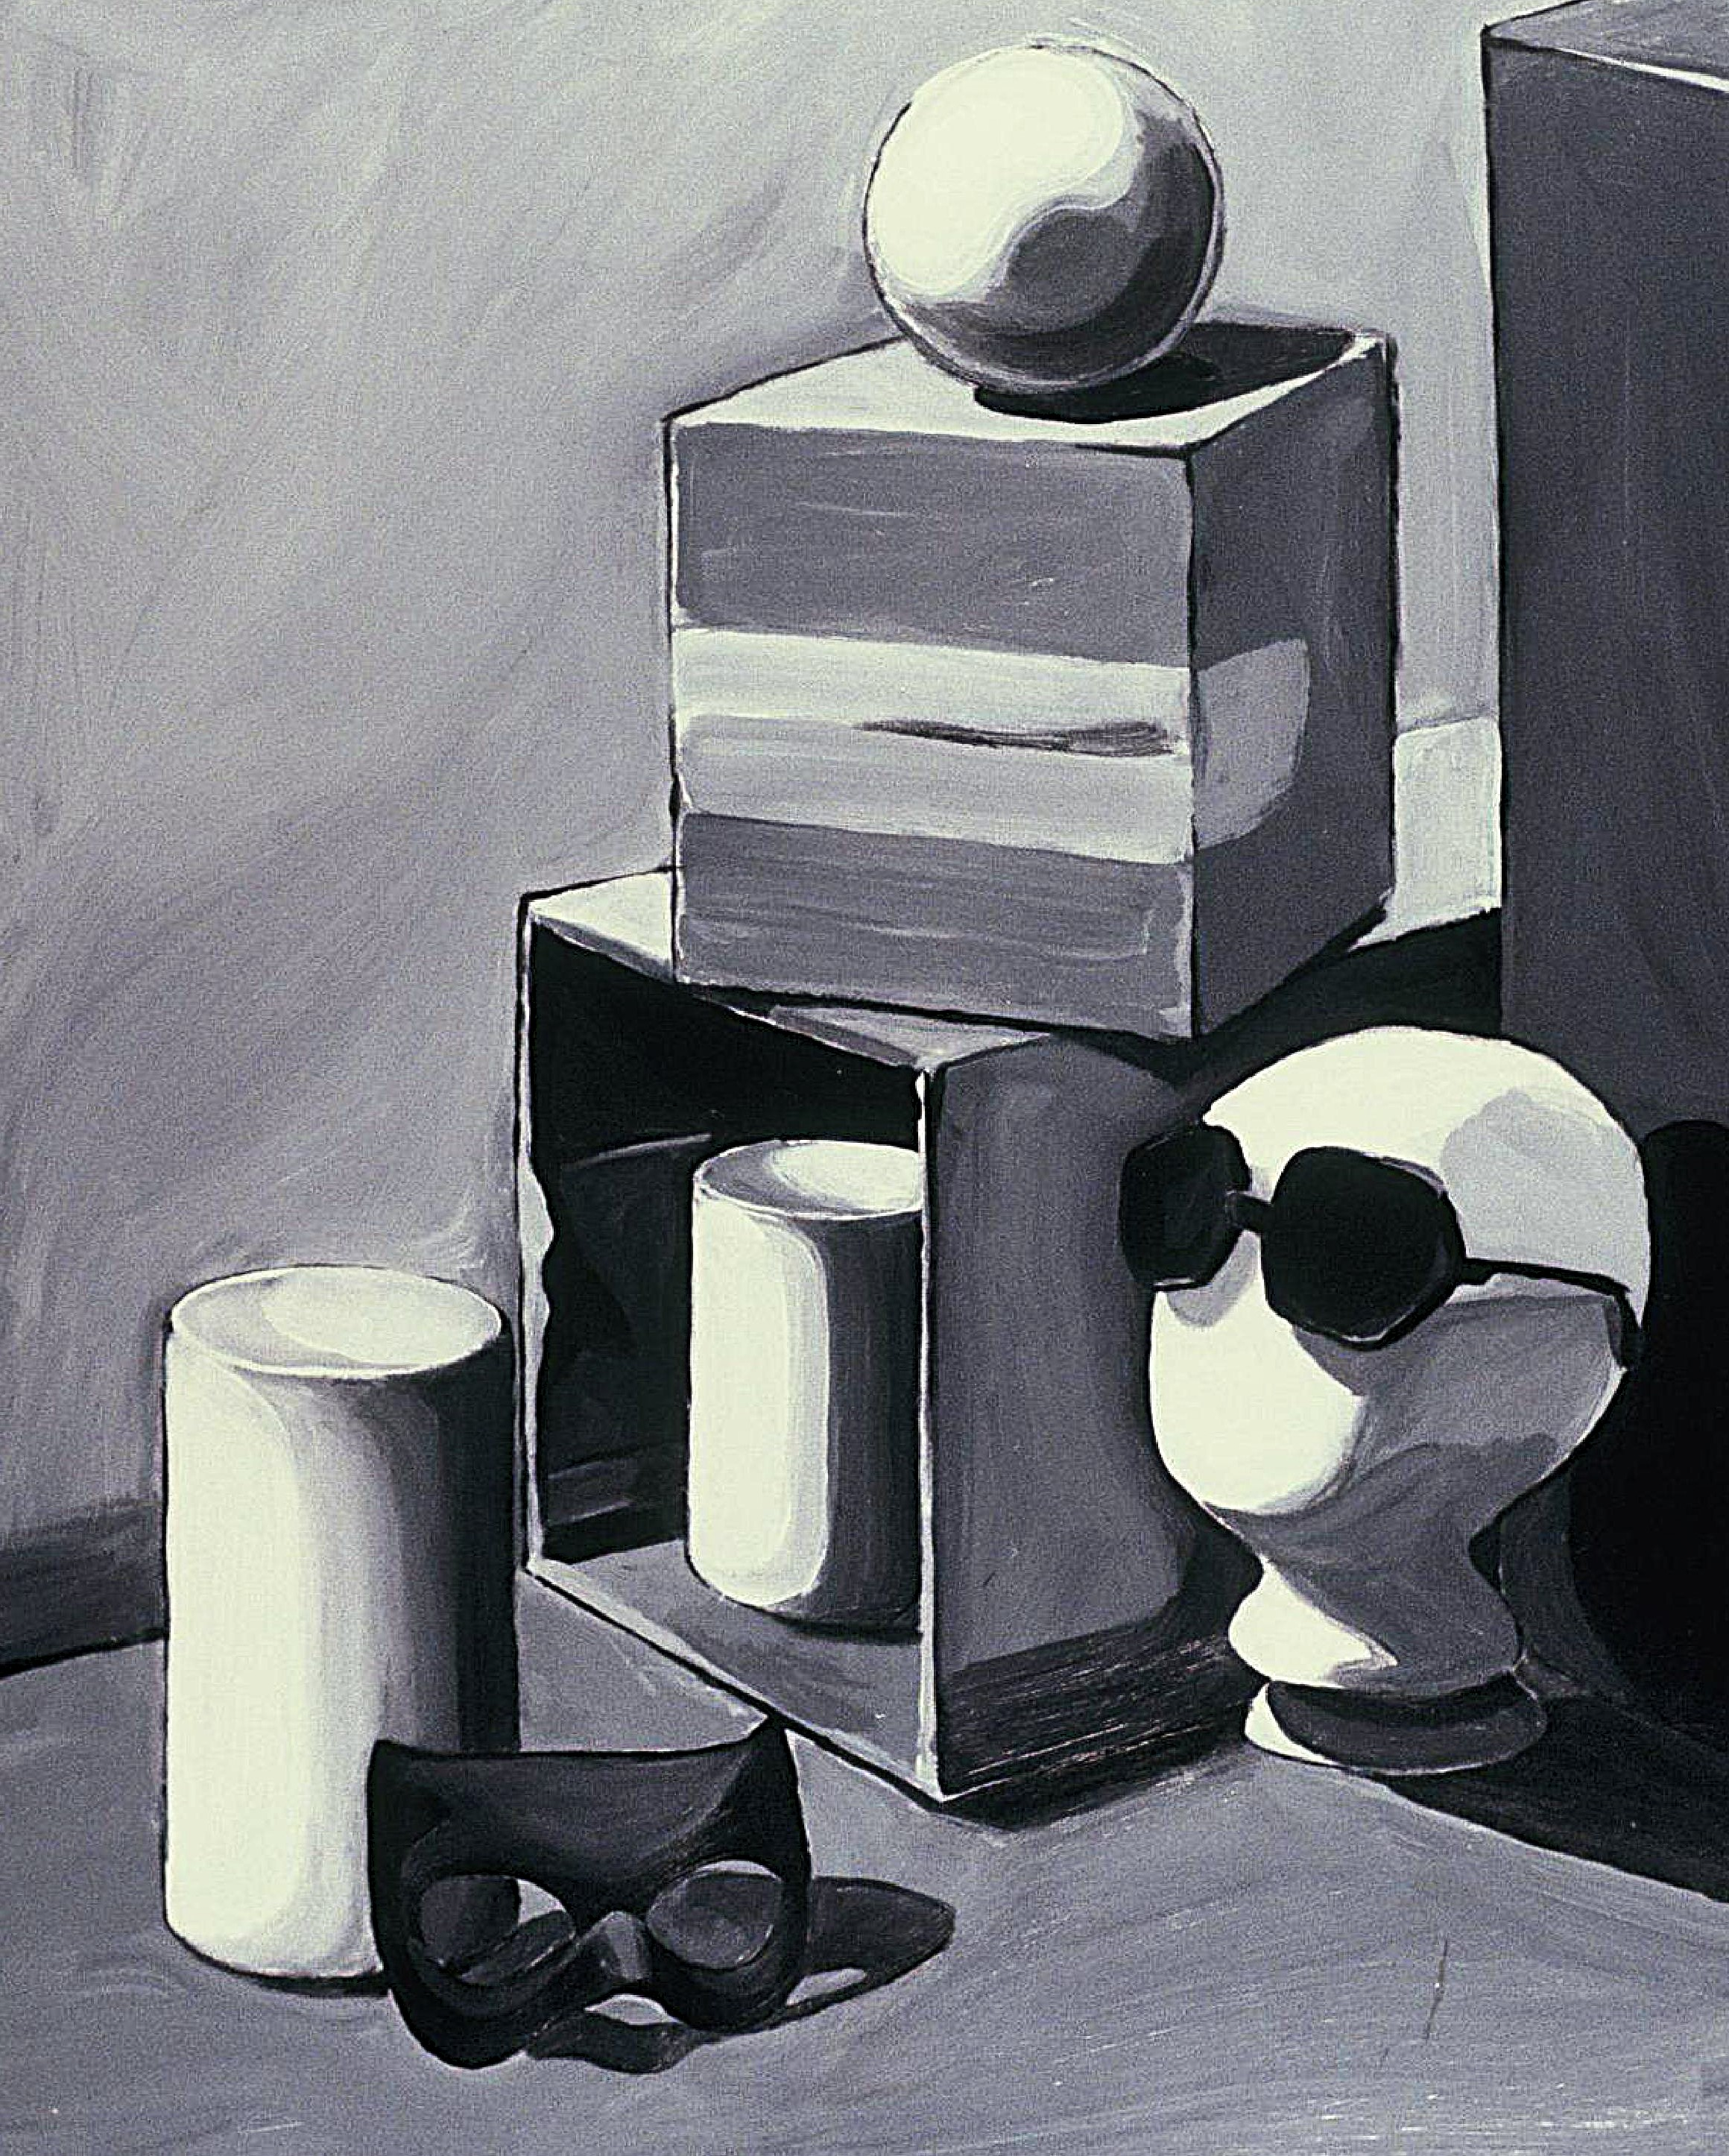
It is advisable to start with a 12th century technique called grisaille painting (French for greyness) ,which means painted using black and white oils such as ivory black and titanium white. Artists used this technique to imitate sculpture in paint. This will aid you in your compositional decisions without color concerns. Think of still life painting as a lab experiment, whereby ,you are free to explore compositional options. Grisaille techniques begin with a charcoal or graphite pencil drawing and advances with a brush drawing in paint. The painting on the right features strong perspective angles and a mix of value or tonal contrast. This painting is drawn with a brush. Your composition may be either a square or rectangular format.

Slide 6
Here is yet another grisaille painting, but a more complex one with a larger compositional format of 30” x 40”.The student incorporated overlapping objects in a rhythmic sequence.

Slide 7
In this student work, we see a limited palette painting using the grisaille technique and a few primary colors. The student cleverly reveals oil painting supplies including an oil paint palette knife, palette, thinner, brushes and linseed oil .Note the reflections in the thinner can!

Slide 8
An earth tone painting is a logical step for the student to transition from the grisaille black and white to one incorporating earth tones such as burnt umber, burnt sienna and yellow ochre. Similar phenomena such as reflection may be studied, as shown in this painting 2 vanitas theme still life.

Slide 9
Another approach is the earth tone painting with the figure and interior spatial theme. This allows earth tones such as burnt and raw umber, burnt sienna and yellow ochre to provide a sense of color without committing to a full blown or committed color composition.

Slide 10
Now, you are ready to add more color, and immerse yourself in your personal painting of a still life as you can see in the following paintings from my painting 1-2 classes, where color and composition are fused together …

Slide 11
This painting is an effective composition of balance and counterbalance. It is painted both confidently and gesturally. Note the solidity of the objects accented with light creating the illusion of three dimensionality and the transparent effect of the oil lamp!

Slide 12
A personal still life in a shadow box, which is used to provide a self-contained space for a composition. The student composed their own objects to paint using primary and secondary colors. Notice the effective blending of the worn-out converse tennis shoes!

Slide 13
In conclusion, we see a complex color composition painting featuring drapery folds, primary and secondary colors and strong color shadows. Color controls the composition with a large range of colors throughout the painting. Some foreground objects have a perspective slant which guides your eye into the middle ground of the composition. This is an achievable goal as you advance in your personal work. Thank you!

