Slide 1
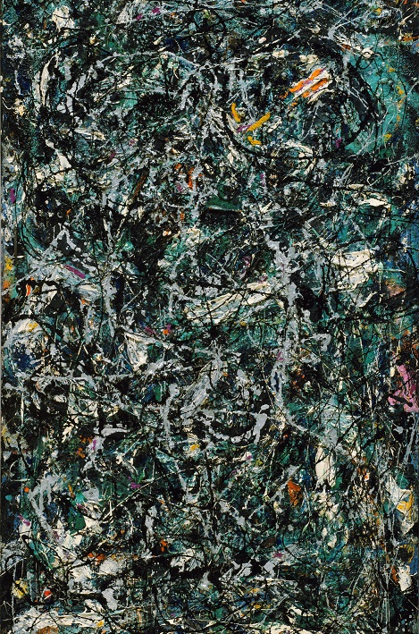

Abstract Expressionism
By
David E. Harmon

Slide 2
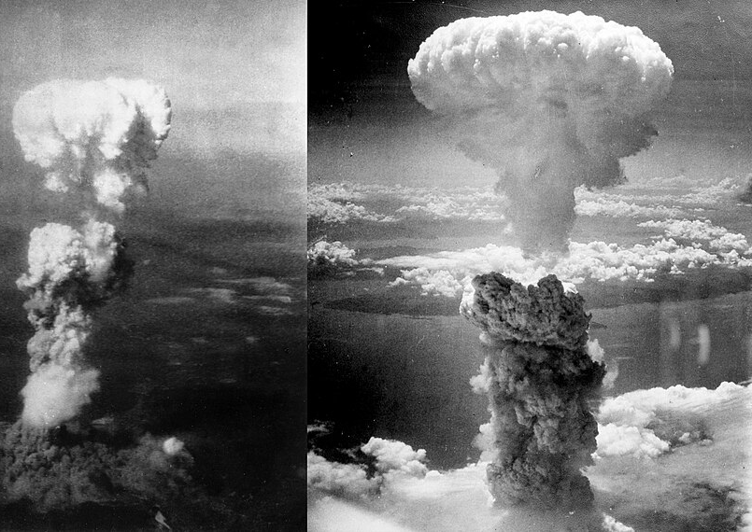
On August 6 and 9,1945,two atomic bombs were dropped by US forces on two Japanese cities, Nagasaki and Hiroshima. 210,00 people were either killed or injured.
Now the world was in the Atomic Age! Nothing would be the same including art!

Slide 3
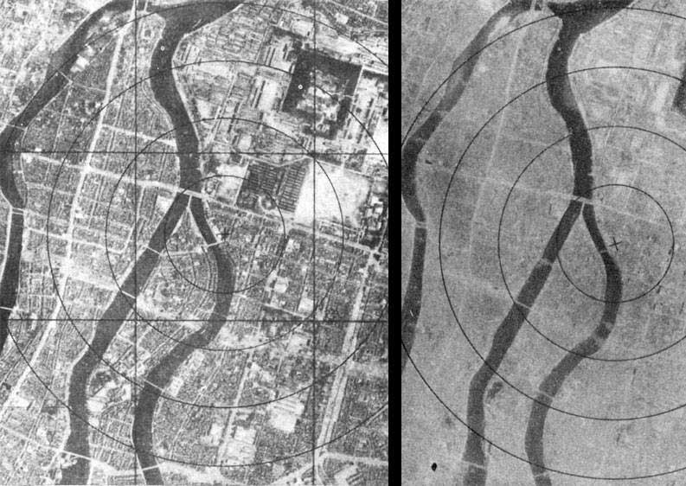
These Japanese city aerial photos are frightening showing both before and the aftermath of the explosion!
Science had produced a tool of absolute terror, plunging society into an era of profound anxiety. How could any artist paint or sculpt realistically with the possibility of mass destruction?

Slide 4
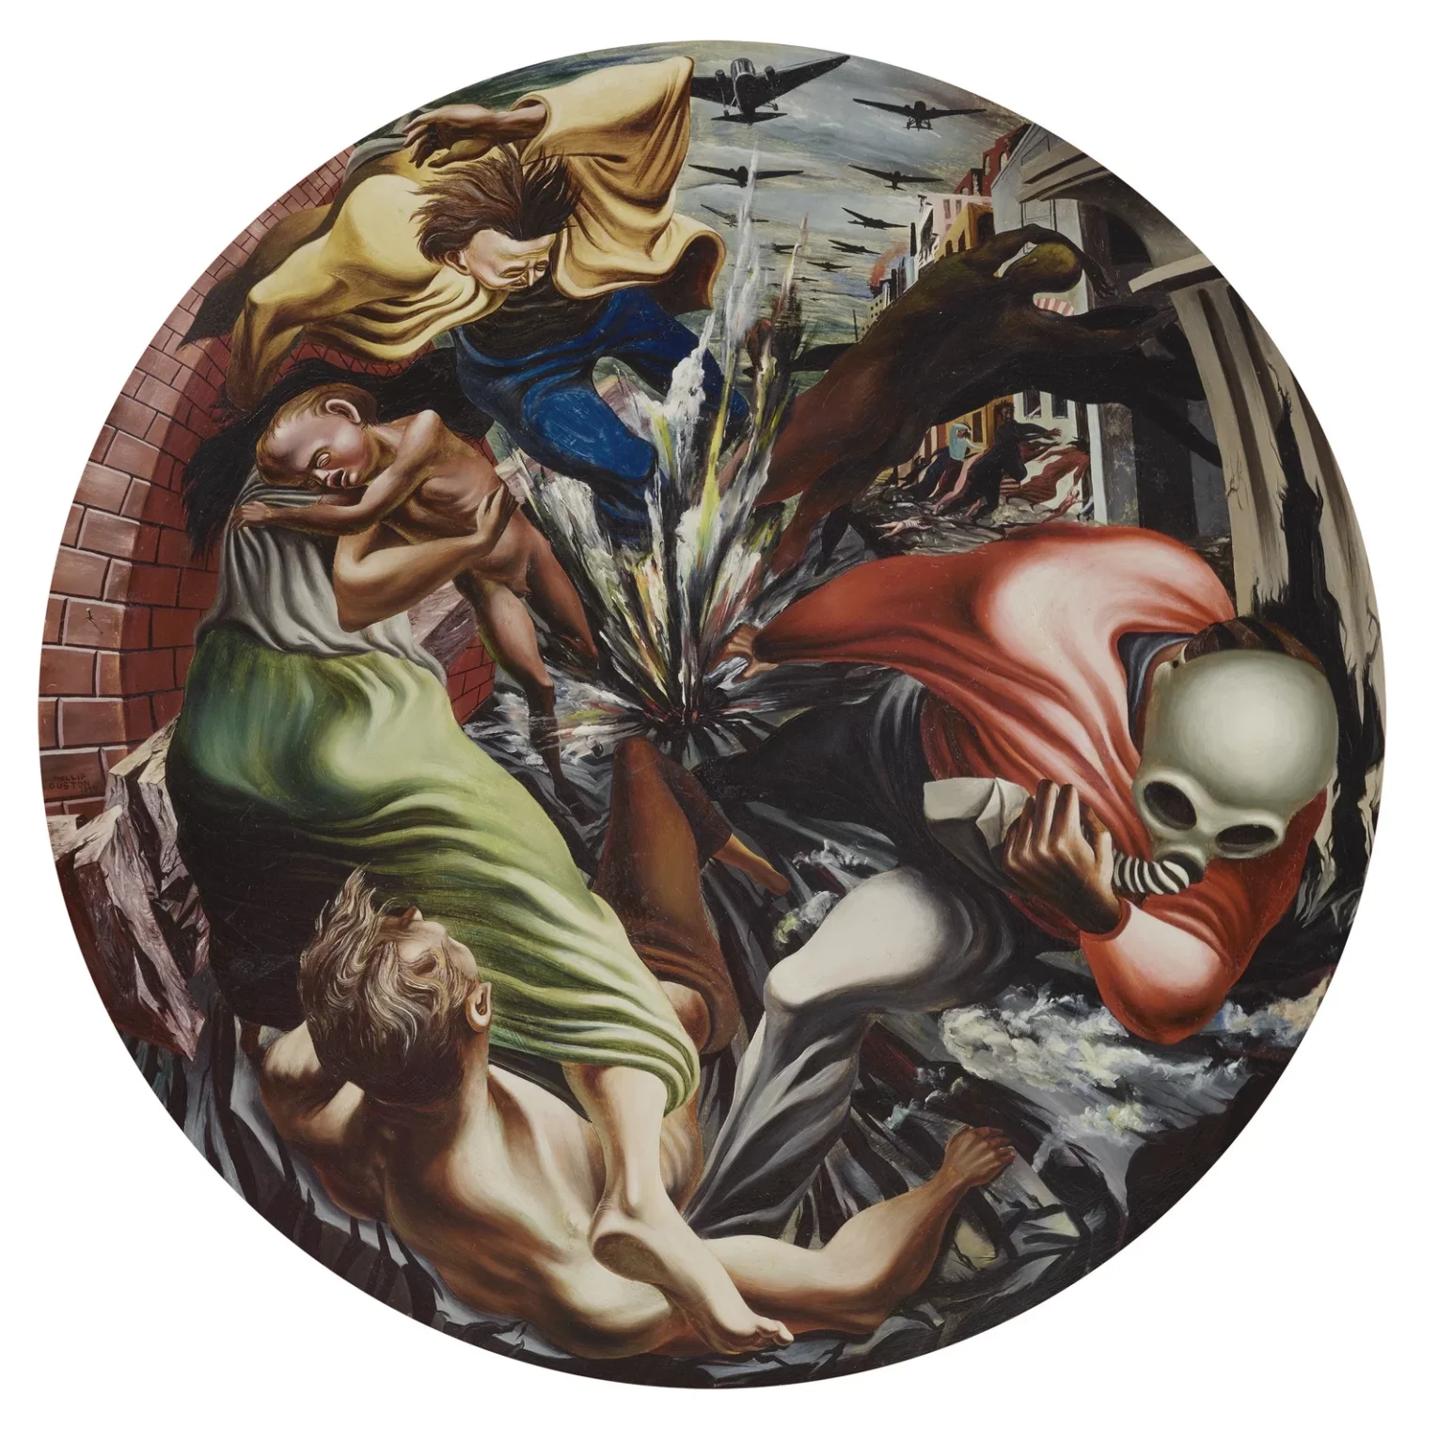
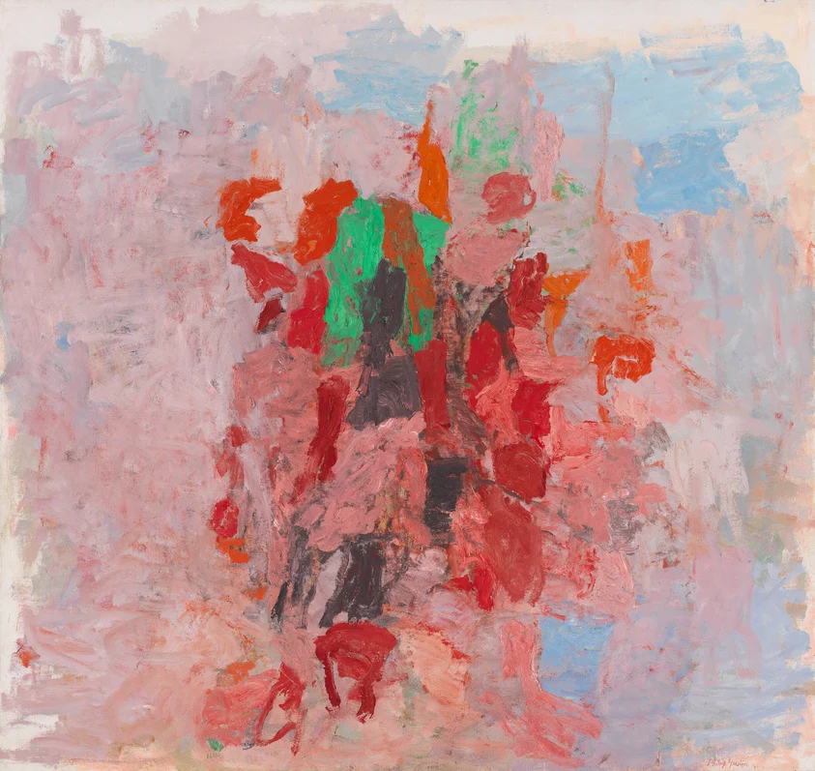
As a result of post WW2 devastation, existential philosophy, and books by Freud and Jung, an artistic movement had begun in New York City in the late 1940’s through the 1950’s. Painters and sculptors had been trained to see the world realistically…now they ,like Philip Guston’s works below, shifted from realism to abstraction, looking inward rather than outward!
Bombardment, oil on canvas,1937
Dial, oil on canvas,1956

Slide 5
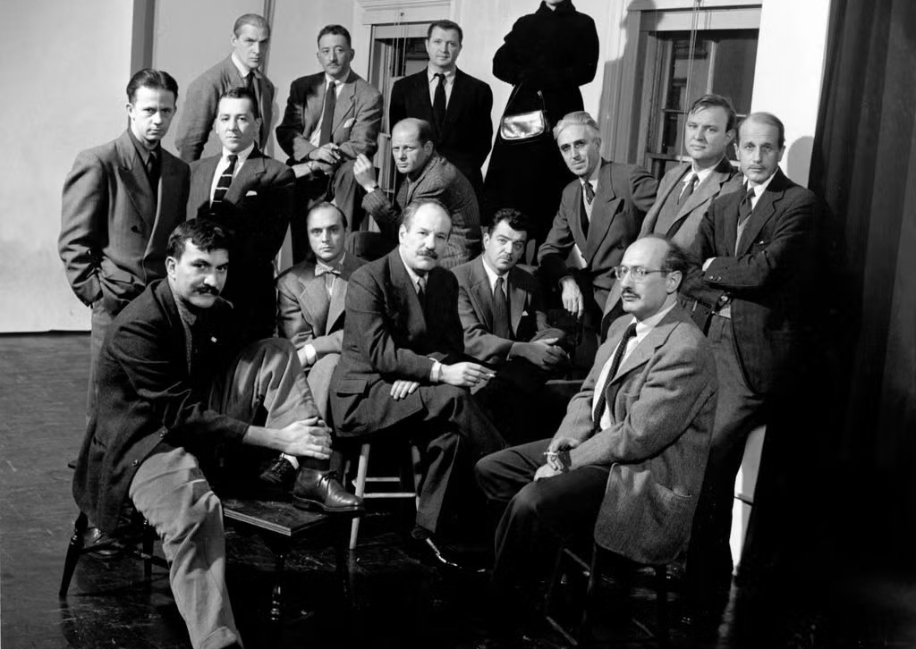
The original Abstract Expressionist painters from 1951.
This is a Life magazine photograph of the 15 original abstract expressionist artists; the New York Times dubbed the New York School.

Slide 6
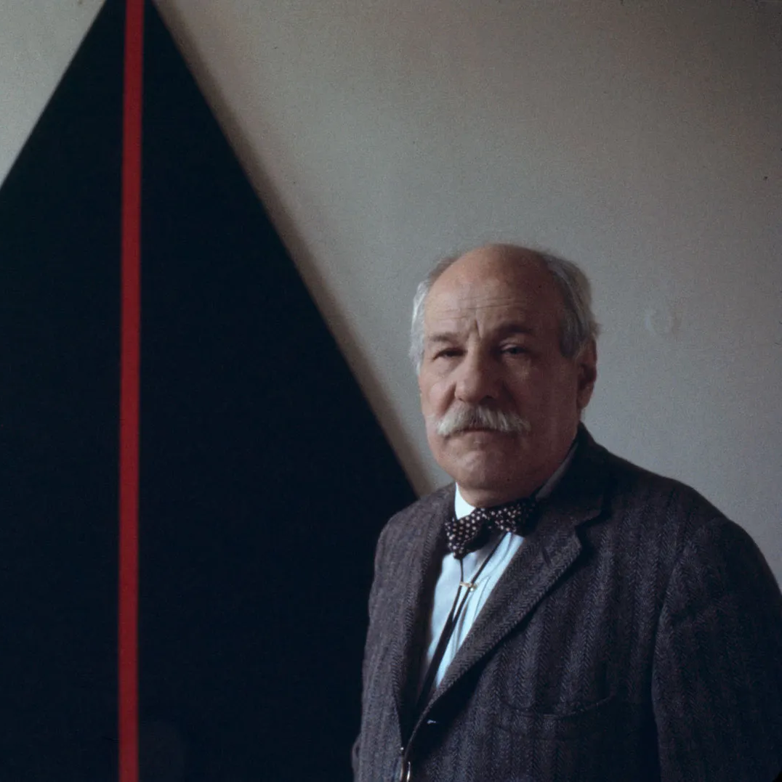
In many ways, Abstract Expressionist movement paralleled the philosophy of existentialism. At its core, existentialism posited that individuals are responsible for creating their own meaning and purpose in what had become a seemingly indifferent universe.
Barnett Newman, an artist associated with the movement, wrote:
We felt the moral crisis of a world in shambles, a world destroyed by a great depression and a fierce World War, and it was impossible at that time to paint the kind of paintings that we were doing—flowers, reclining nudes, and people playing the cello.

Slide 7
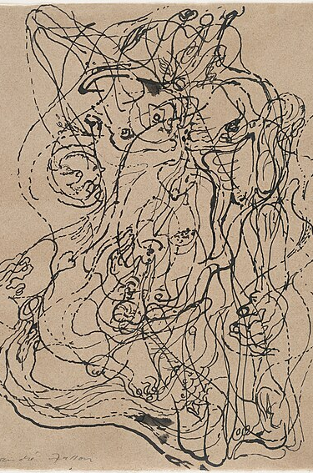
These artists were diehard individuals who disliked labels and preferred an expression of painting which employed the concept of automatism they borrowed from the European Surrealist movement. One simply draws automatically without preplanning.
<This is a 1924 drawing by Andre Masson entitled Automatic Drawing.

Slide 8
Gesture and color became two routes to inner experience
One emphasized the artist’s motion; the other emphasized the viewer’s immersion.
A
C
ACTION PAINTING
COLOR FIELD
Gesture made visible
Emotion made spacious
Fast, physical brushwork
Drips, sweeps, and layered marks
The canvas records the act of painting
Broad areas of color
Quiet surfaces and reduced gesture
The canvas becomes an immersive field
POLLOCK • DE KOONING • MITCHELL
ROTHKO
Across both paths, abstraction made feeling—not realism—the subject.

Slide 9
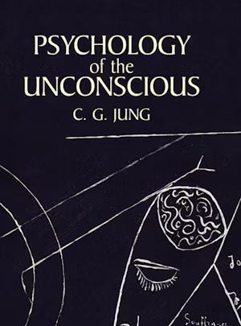
Painters such as Jackson Pollack sought to make art without conscious control to release his inner psyche. He worked fast and large in a style called action painting!
We will now look at the work of five of the major artists of this movement:
Jackson Pollack
Willem DeKooning
Marc Rothko
Grace Hartigan
Joan Mitchell

Slide 10
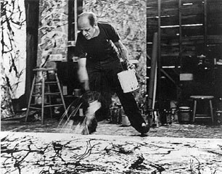
Jackson Pollack:
Action Painter quotes…
It seems to me that the modern painter cannot express his age, the airplane, the atom bomb, the radio, in the old forms of the Renaissance or any other past culture. Each age finds its own technique.
On the floor I am more at ease. I feel nearer, more part of the painting, since this way I can walk around it, work from the four sides and literally be in the painting.
This Photo by Unknown Author is licensed under CC BY-SA

Slide 11
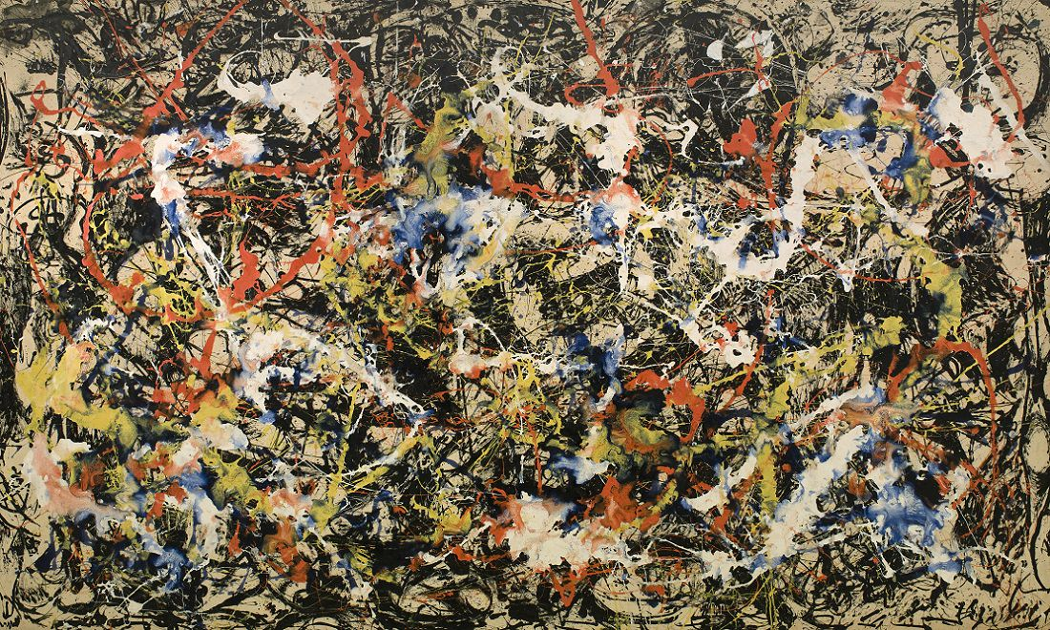
Pollack’s Convergence,1951,oil on canvas,93” x 155”-His canvases were huge in size!

Slide 12
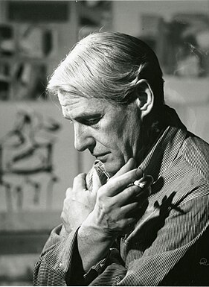
Yet another abstract expressionist was Willem Dekooning. He was born in Holland. I interviewed him in the 1980’s in his East Hampton studio in Long Island, NY.
Quote: The idea that an artist puts order into the chaos of nature is absurd. All we can hope for is that we can put some order into ourselves.

Slide 13
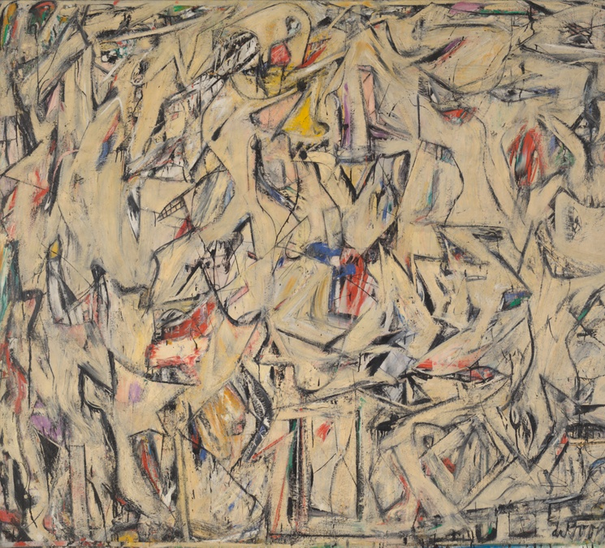
DeKooning’s Excavation, measuring 81” x 100”,an oil on canvas, painted in 1950. It is considered his best painting. Abstract portions of the human form appear throughout the painting.

Slide 14
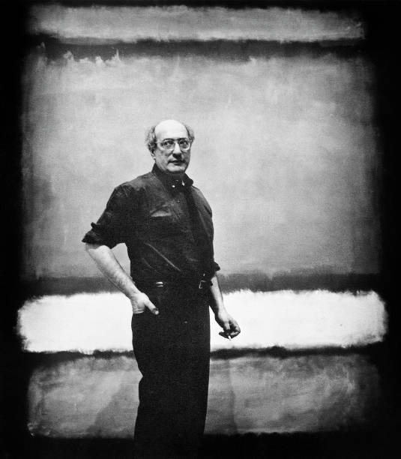
Marc Rothko was an abstract expressionist painter whose canvases were called color field paintings, conveying intense meditative color with little evidence of brush strokes.
Quote: The artist invites the spectator to take a journey within the realm of the canvas... Without taking the journey, the spectator has really missed the essential experience of the picture.

Slide 15
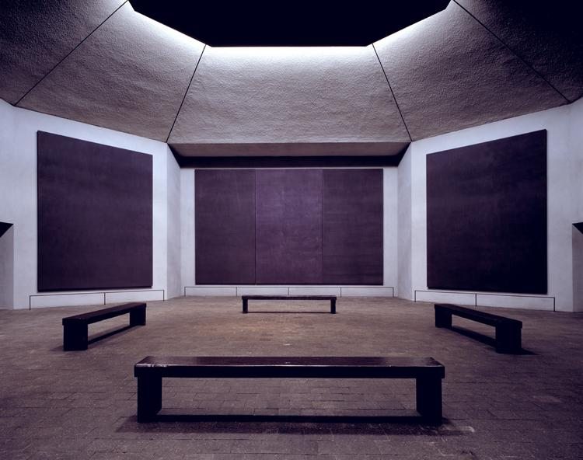
This is the famed Rothko Chapel located in Houston, Texas. It contains 14 Rothko paintings. I have seen it on several visits.
The Rothko Chapel...became the world's first broadly ecumenical center, a holy place open to all religions and belonging to none.

Slide 16
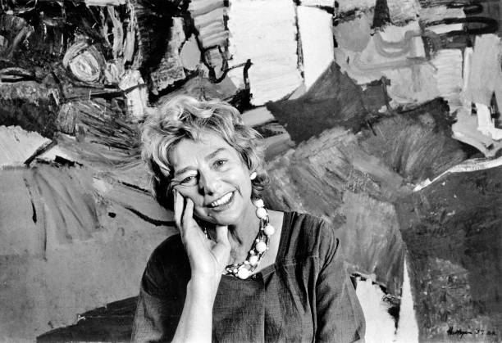
Grace Hartigan: a second-generation Abstract Expressionist
The impulse to search, question, and change is a recurrent theme in Hartigan’s life and work.
Quote: I want an art that is not ‘abstract’ and not ‘realistic.

Slide 17
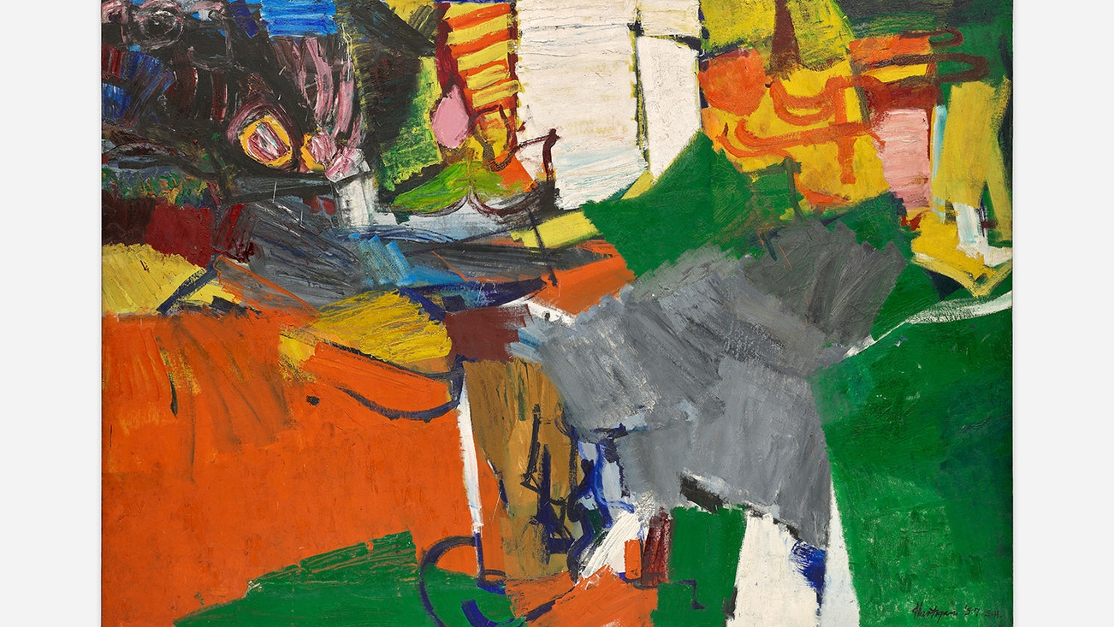
Hartigan’s Montauk Highway, oil on canvas, 91” x 128”,1957

Slide 18
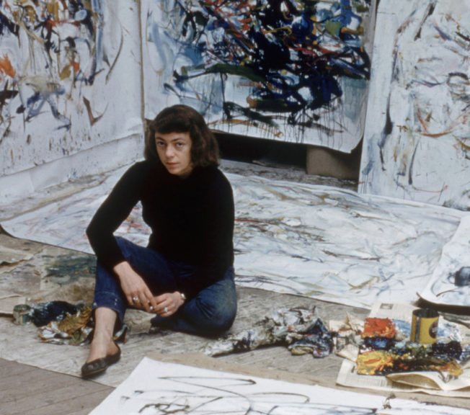
Joan Mitchell
Quote: My paintings are titled after they are finished. I paint from remembered landscapes that I carry with me and remembered feelings of them, which of course become transformed.

Slide 19
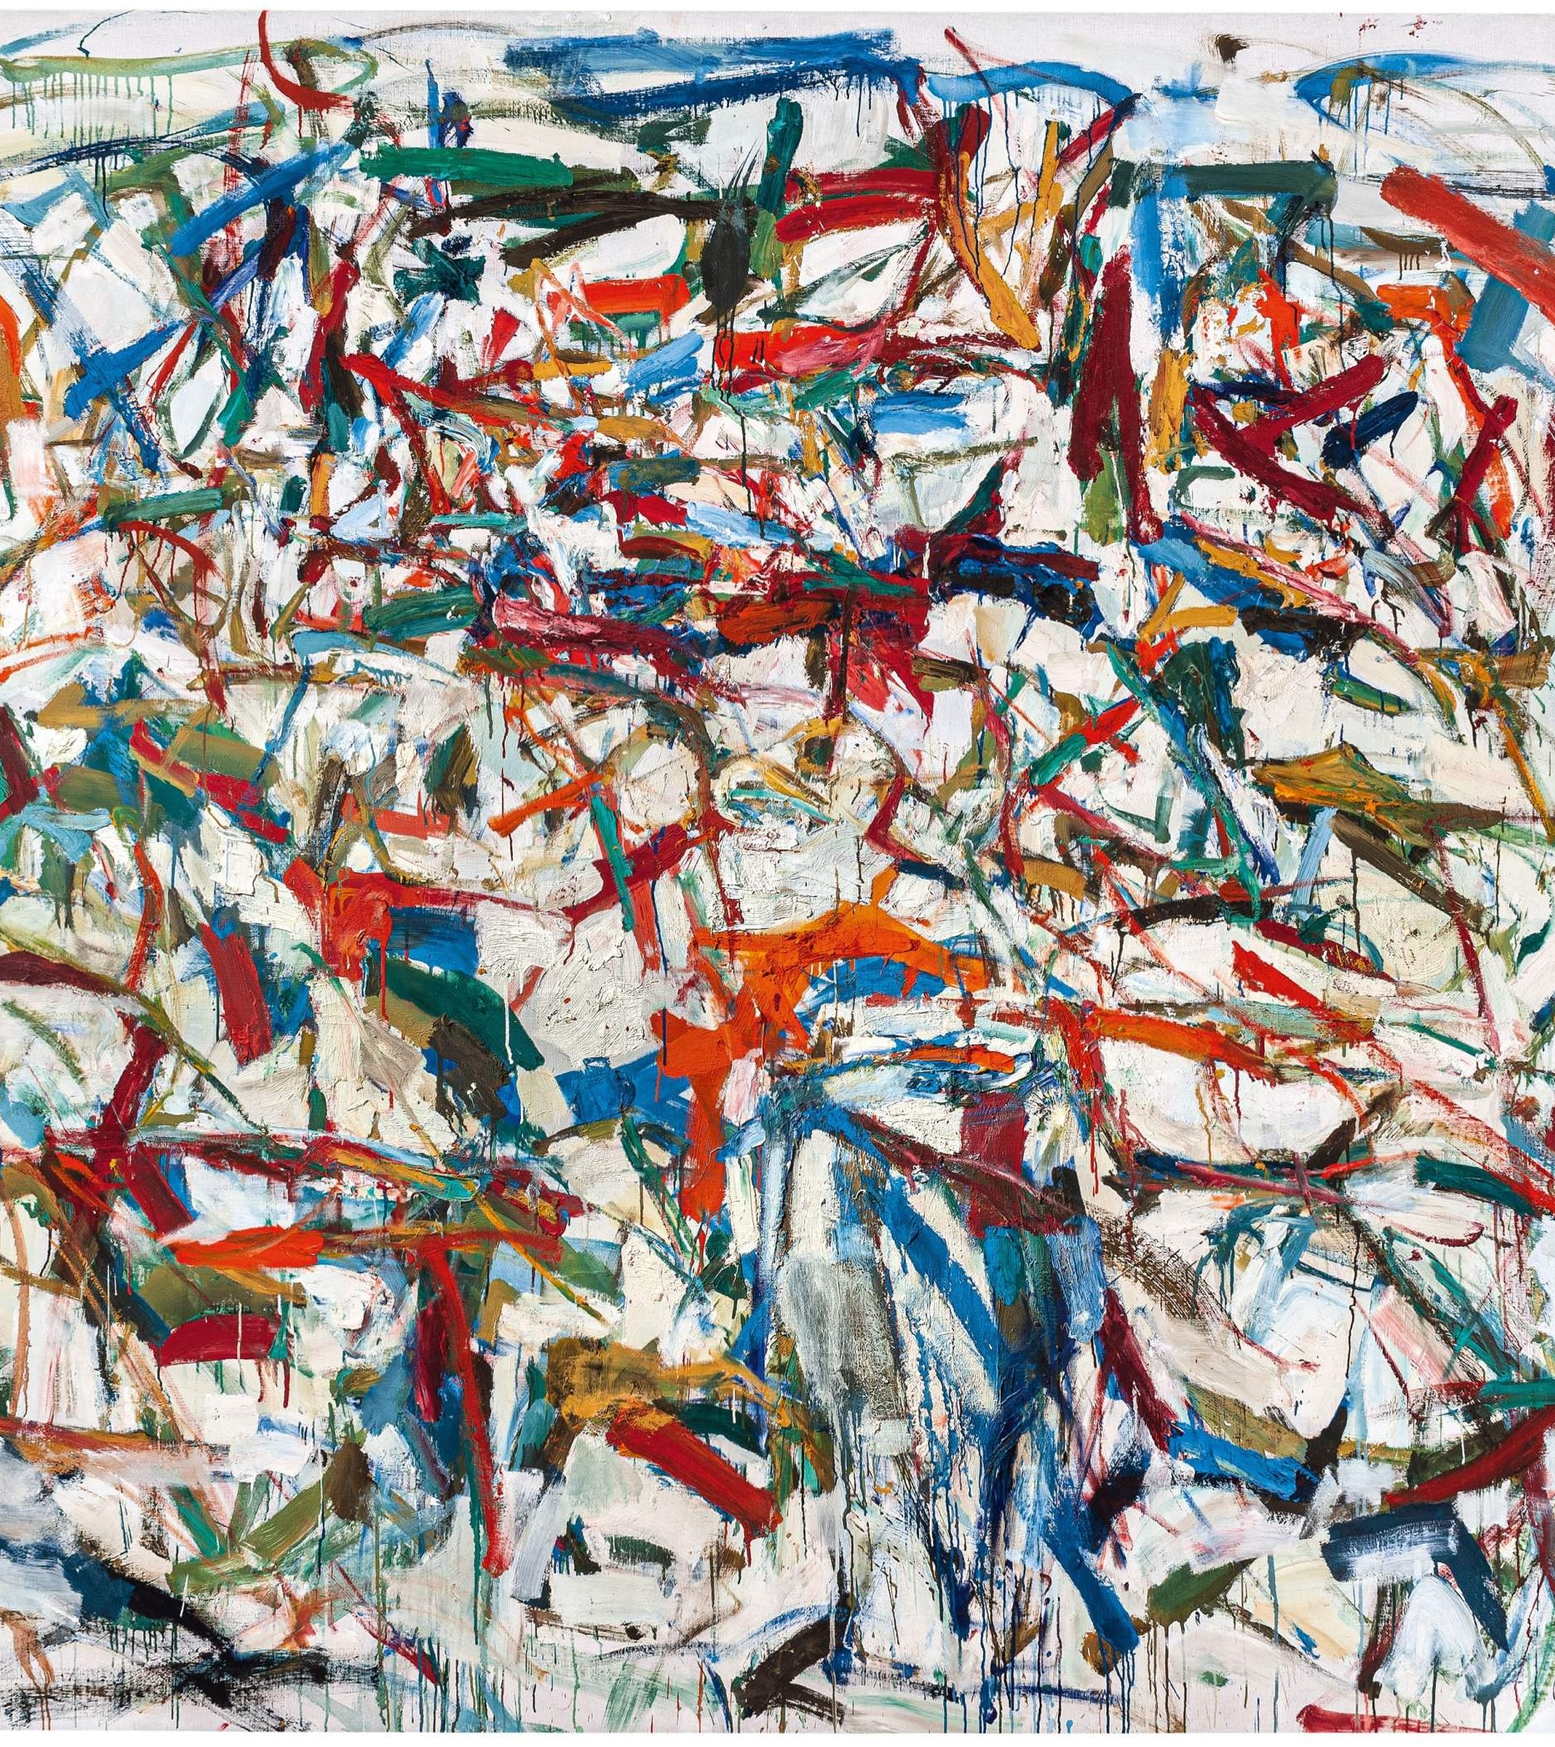
Mitchell's, Evenings on 53rd Street, oil on canvas, 75” x 85”,1957.
We will now view a rare video clip from the 1950’s on Jackson Pollack in the act of painting and discussing his process…

Slide 20


Slide 21
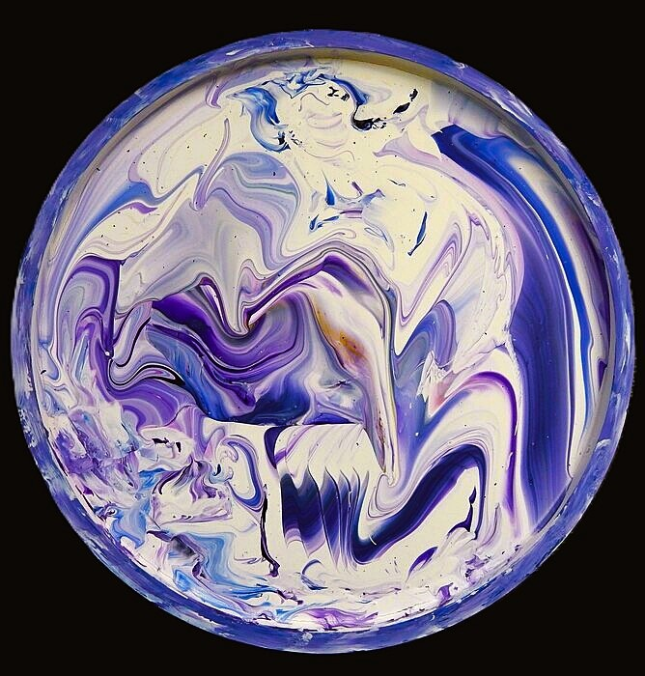
My abstract painting Fiat Lux or let there be light was painted in 2025.It is an acrylic on panel painting measuring 24” in diameter. I have included it as I too, have been influenced by Pollack and his famous drip technique.
This work is currently on exhibition in the Jan Dempsey Art Gallery, Auburn, AL. September 17- October 24, 2026.

Slide 22
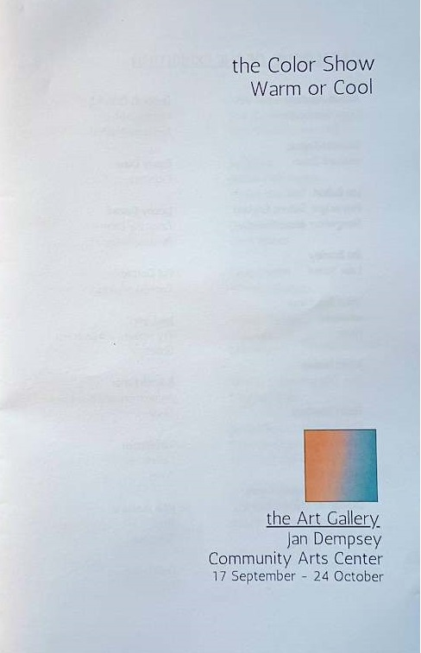
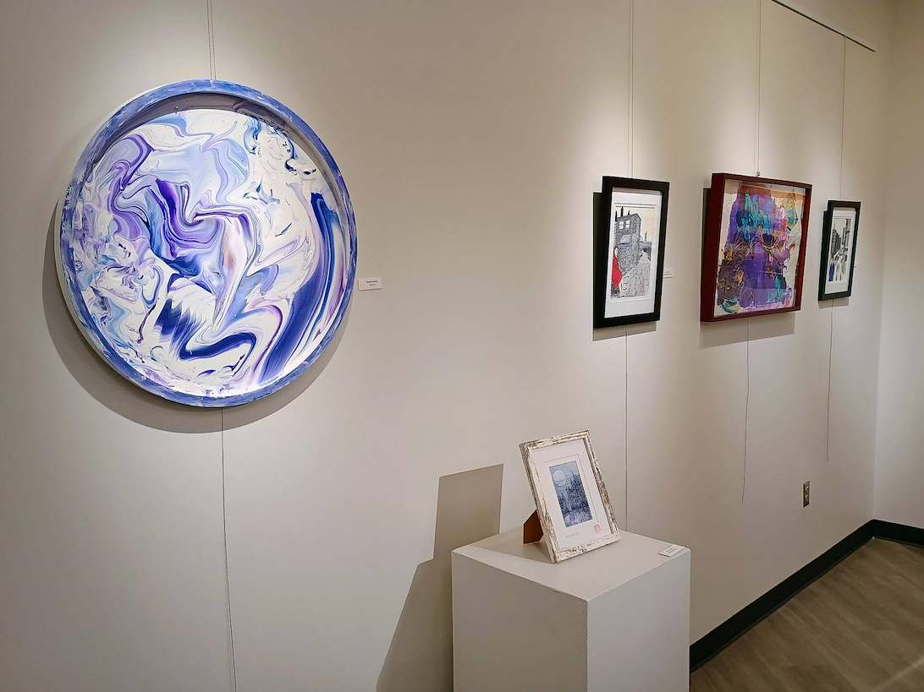
The Color Show, Jan Dempsey Art Gallery
Thank you!

