Slide 1
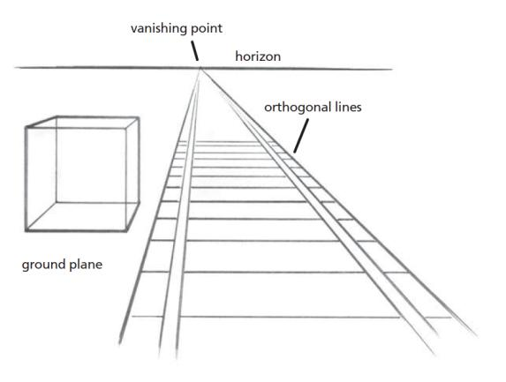
An Art Appreciation Element: The Illusion of Space
_________________
The Invention of One-point Linear Perspective: Ancient Rome through The Italian Renaissance and Today
A teaching demonstration by
David E. Harmon

Slide 2

A brief definition and history:
Linear Perspective is defined as “parallel lines converging to a single point on a horizon line ,referred to as the vanishing point.” There are other historic perspective systems such as tiered ,whereby images of architecture and people appear to be “stacked” upon one another. However, with the breakthrough paintings of Giotto in the 14th century in Italy, we experience a convincing method to record the real world as we see it. The Roman Empire was a vast architecturally oriented society.
Architecture linked with engineering had become the most important art form as structures and roadways needed to be built to accommodate the needs of this growing civilization. Historians speculate that they drew sketches of buildings, and believable interior scenes to decorate villas. There are no paper sketches to be found, only ruins are left. Even these reveal planning.
Fortunately, some have been painted in the fresco wall technique preserved in Pompeii, Italy. In these structures we find perspective wall painting. The best preserved ,due to the eruption of Mt. Vesuvius and its subsequent burial of Pompeii in ash, are the villas. Their walls were decorated with illusionistic wall paintings to aesthetically beautify these interiors.
In 2000, my students and I visited Naples and Pompeii and viewed many fresco paintings such as seen in the following slide:

Slide 3
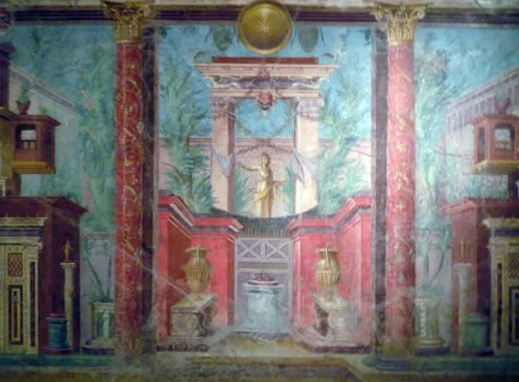
Here, we see an attempt to provide one point perspective illusion painted in 50-40 BCE of an interior setting in the Cubiculum (bedroom) in a Villa, located in Pompeii, Italy.
The villa was buried in ash and preserved from the 70 CE eruption in Pompeii. The heat of the volcanic ash effectively sealed the painting in a glass like coating!

Slide 4
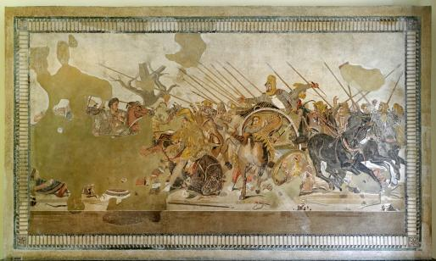
Scholars speculate that the ancient Greeks may have discovered perspective, passing this knowledge to the Romans.
The image to the right shows Battle of Issus ,in mosaic (colored glass/stone).Created in 100 BCE in Naples, Italy, it depicts Alexander the Great in battle with foreshortened horses galloping toward the viewer and a ground plane set in realistic space!

Slide 5

Utagawa, a 19th century Japanese printmaker created a landscape which hints at linear perspective especially in the village hut toward the center of the composition.
Rather than using a codified system of perspective , the artist relied more on intuitive space such as overlapping shapes gotten through life observation.

Slide 6
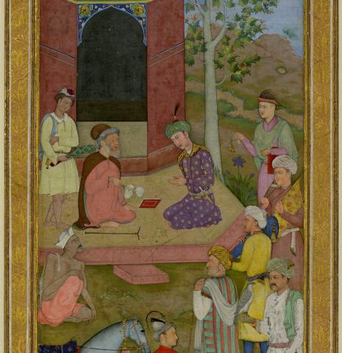
Here in a 16th century painting by Farrukh Beg of the Mughal Indian empire, we see a young nobleman visiting a holy man. Here we view tiered perspective, whereby, figures and animals are stacked and overlapping one another. It is east to critique this non-western work according to western spatial standards. However, the artist’s intent was to paint this event in the best way he knew possible.

Slide 7
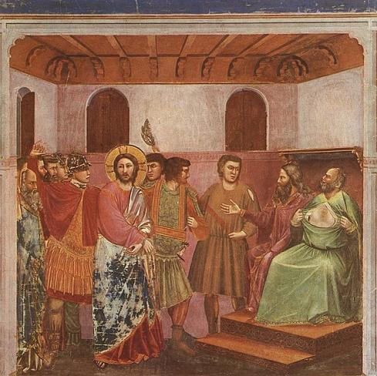
Early Italian Renaissance painter, Giotto di Bondone (1277-1337 CE) is considered the father of linear perspective with his window opened to the world technique. His painting Jesus before the High Priest Caiaphas was painted in 1305 for the Scrovegni Chapel in Padua, Italy.

Slide 8
This painting reveals ceiling rafters.
These appear as converging lines receding in believable space behind the wall. This image opened the interior viewing space providing the illusion of depth perception. The artist uses observational logic to paint this effective image without the linear perspective formula.

Slide 9
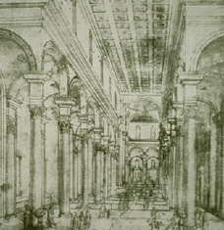
The first drawing of linear perspective was created by the Florentine and early Italian Renaissance architect Filippo Brunelleschi (1377-1446 CE).
Drawn on paper in 1415 CE, it depicted, in true linear perspective , the Baptistery in Florence from the front gate of the unfinished cathedral. Brunelleschi needed a blueprint before he could design and build. Linear perspective became that great discovery developed through practice and reason!
We can see columns appearing smaller in size as they recede in space.
Perspective provides the illusion of depth perception on a flat surface such as paper and canvas.

Slide 10
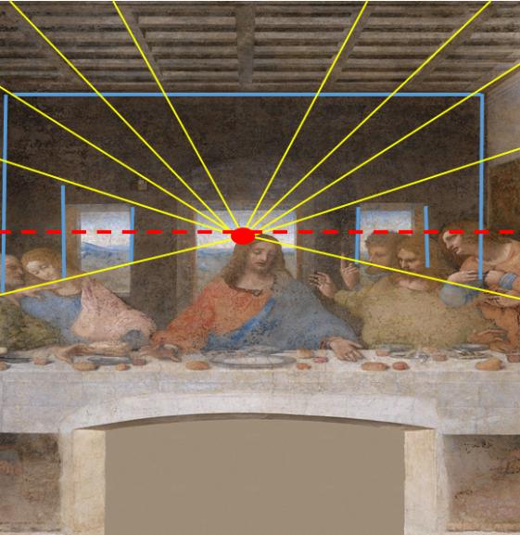
Leonardo Da Vinci’s fresco painting of
The Last Supper is a classic example of one-point perspective replete with a vanishing point, horizon line and several converging lines centering on the head of Christ as the vanishing point.

Slide 11
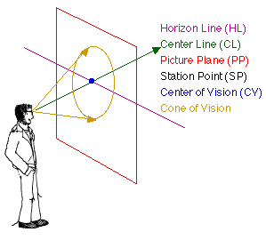
The One-point Perspective Drawing Process
One point perspective is composed of three components:
A horizon line
Converging or orthogonal lines leading to…
A vanishing point
This type of perspective requires the viewer to be placed in a station point relative to their view. The diagram on the right, illustrates our cone of vision revealing these basic aspects. The next slide shows the following photographs composed by me revealing the same pathway near the Missouri river in Kansas City, MO.:

Slide 12
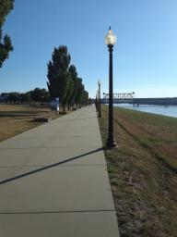
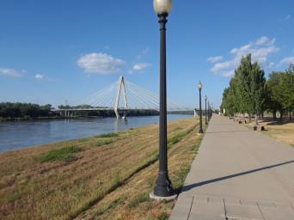
The vanishing point is in the center of the vertical image and located approximately 2/3 from the bottom of the left photograph. Note that the riverbank evenly spaced lampposts and planted trees all converge to a vanishing point in the distance from a standing station point view.
In the second horizontal photograph, the vanishing point is located center right. The river follows the path to the right until it curves to the left in the distance. The front lamppost blocks the curve view.
The horizontal photograph provides a wider angle and spatial view of this landscape while still conveying one point perspective. Note that the lampposts, trees and shadows all appear to recede into the distance. Remember that this is an illusion. When viewed from the side, all these objects are of the same size. It is the direction of viewing a scene and our individual station point which provides the depth perception gotten through linear one point perspective.

Slide 13
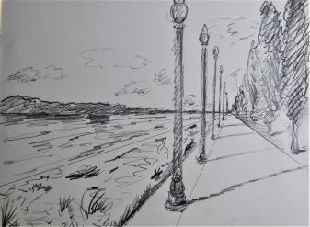
Here we see a photographic reference image and gesture sketch taken and drawn by me depicting a horizon line, vanishing point and converging lines.
One point perspective reference photograph.
One point perspective gesture sketch.

Slide 14
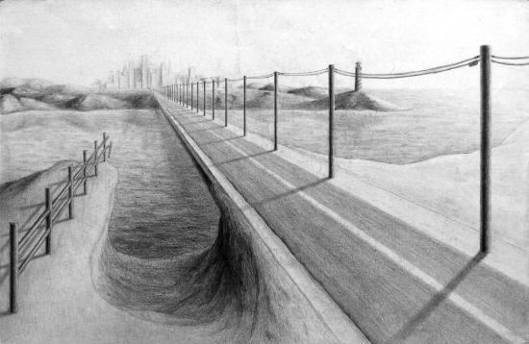
A drawing begins with a loose gesture sketch which can advance toward a state of finish, seen in this student drawing of a roadway.

Slide 15
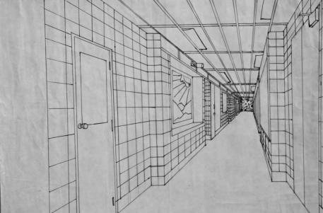
Another student drawing ,drawn from direct observation, reveals a long interior hallway image leading the eye toward a vanishing point in the distance using several converging lines. The floor plane, ceiling panels and tile walls all recede in space, providing the illusion of depth.

Slide 16
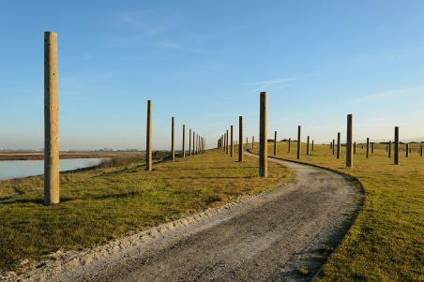
In this photograph we can clearly see one point perspective combining in a more complex image including hard edge objects (posts)and an S curve road receding in the distance. Here we see multiple one-point perspectives.

Slide 17
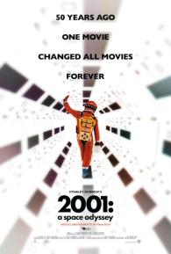
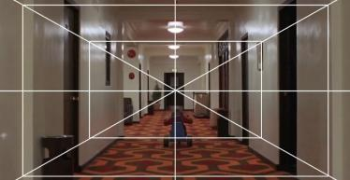
Filmmaker Stanley Kubrick used one-point perspective theory in films such as…
2001: A Space Odyssey (1968)
The Shining (1980)

Slide 18
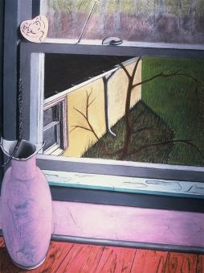
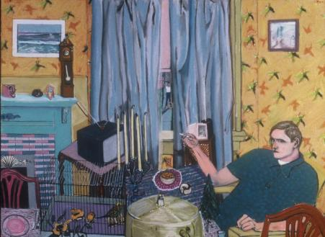
I have used one point perspective in both my pastel drawings and paintings. In some images, One-point perspective is implied by angles rather than clearly seen. Other art works are more obvious.

Slide 19
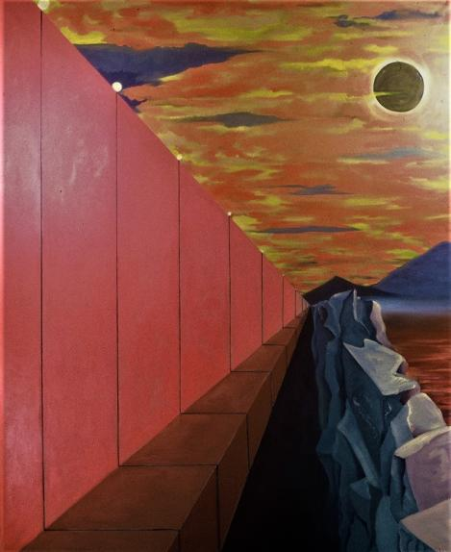

Slide 20
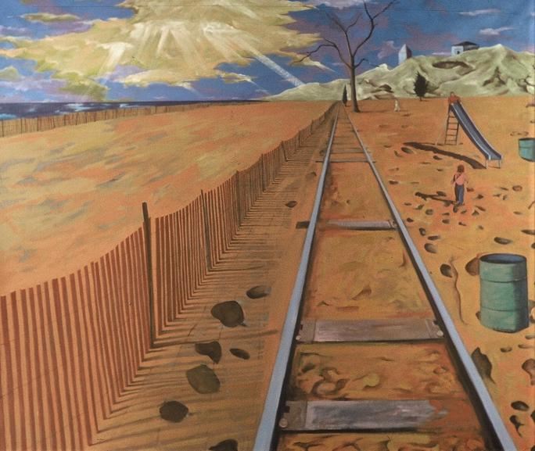

Slide 21
In conclusion, artists learn the essentials of historical Italian Renaissance one-point linear perspective technique. Artists use this drawing procedure to serve their own creative vision to provide illusionistic depth perception. The legacy of this 607-year-old technique, structures how we really see and perceive the world from our binocular vision and station viewing points .

